Slide 1
29 April 2020
Webinar: Sharing data with EFSA

Slide 2
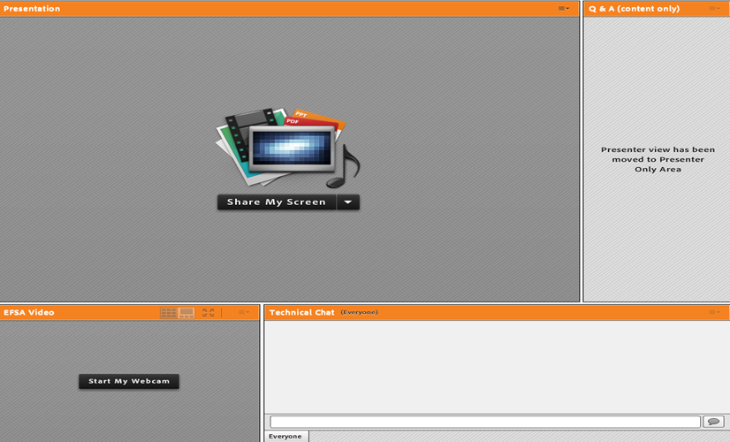
Webinar guide for attendees
This webinar is being recorded!
The webinar is in English and questions should be submitted in English through the platform (see hereunder).
You are automatically connected to the audio broadcast. One-way audio (listen only mode).
Presentation
window
Q&A box: For any questions related to the topic

Slide 3
Sharing data with EFSA – 29 April 2020
Q&A

Slide 4
Thank you for
attending our webinar!
In case we did not manage to answer all your questions, please feel free to re-submit them via e-mail data.collection@efsa.europa.eu
Please take 5 more minutes to fill out the evaluation form that you will receive shortly in your inbox. Your feedback will help us improve our service!

Slide 5
Useful links
Template and guidance available in ‘Call for continuous collection of chemical contaminants occurrence data in food and feed’ http://www.efsa.europa.eu/
Chemical Monitoring Guidance 2020:http://www.efsa.europa.eu/en/supporting/pub/en-1796
Catalogue browser: http://www.efsa.europa.eu/en/supporting/pub/en-1726
Catalogues on Zenodo: https://zenodo.org/record/3243215#.XpWwEMgzbIU
EFSA You Tube Channel:https://www.youtube.com/user/EFSAchannel

