Slide 1
17th October 2019
Dossier preparation for fruits of Momordica coming from countries where Thrips palmi occurs
Webinar
Notes:
Ciro: Welcome back to out Webinar. Here it comes the second section of todays presentation.

Slide 2
Webinar Outline
Introduction: Regulation (EU) 2016/2031 and High Risk Plant dossiers from non-EU countries
Proposed methodology for the compilation of the pest list
How to prepare a pest list? Webinar 1
Q&A on the proposed methodology
Dossier for fruits of Momordica L. and final Q&A
How to prepare a dossier for Momordica fruits? Webinar 2
2
Notes:
We are going to introduce the specific case of the preparation of dossiers for the fruits of Momordica. You can continue to submit your questions for the whole duration of the presentation, and you will still have a few mins at the end to submit and receive answers.

Slide 3
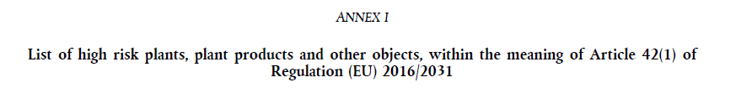
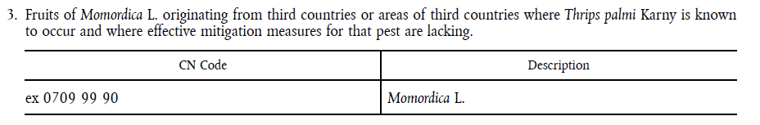
Momordica L. in the legislation on High Risk Plants
List of High Risk Plants
Commission Implementing Regulation (EU) 2018/2019
Prohibition from 14 December 2019 pending risk assessment.
3
Notes:
So, as already mentioned, Momordica is listed in The Commission Implementing Regulation 2018/2019 together with other high risk plants, plant products and other objects which introduction into the EU territory shall be prohibited pending a risk assessment.
Momordica is a peculiar case since the legislations refer to the fruits of this plant, which can pose a risk because of the pest Thrips palmi

Slide 4
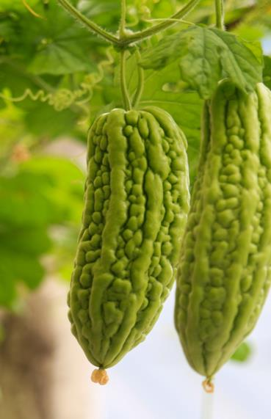
High Risk Plant: fruits of Momordica L.
Fruits of Momordica L. are known to host and provide a significant pathway for the introduction and establishment of the pest Thrips palmi.
For the import of fruits of Momordica L. is needed:
- an official statement by NPPO of the country that the fruits originate in a country, or area within the country, recognised as being free from Thrips palmi.
- or data on risk mitigation measures, see EFSA Technical Report. Prepare a dossier for which EFSA will carry out a Risk Assessment
Which are the data and information required to initiate High Risk Plant (HRP) Risk Assessment for fruits of Momordica L. (dossier)?
4
Notes:
Fruits of Momordica L. are known to host and provide a significant pathway for the introduction and establishment of the pest Thrips palmi, which is known to cause damage on plant species which are of a major economic, social or environmental importance to the Union territory.
In view of this, when fruits of Momordica L. originate in countries or parts of these where that pest is known to occur, it is necessary to submit a dossier to the EC following the TR published by EFSA.
If your country is pest free or your plantations are located in a PFA, it is sufficient to have an official statement by the NPPO of the country

Slide 5
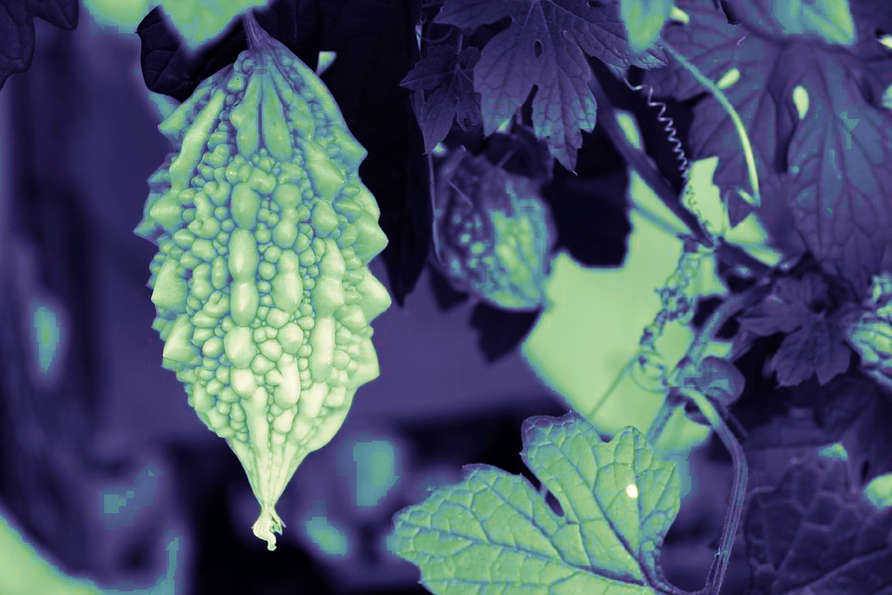

Dossier for fruits of Momordica L.: what do you need to include?
Notes:
Now we are going to show what you need to include in the dossier for fruits of Momordica.

Slide 6
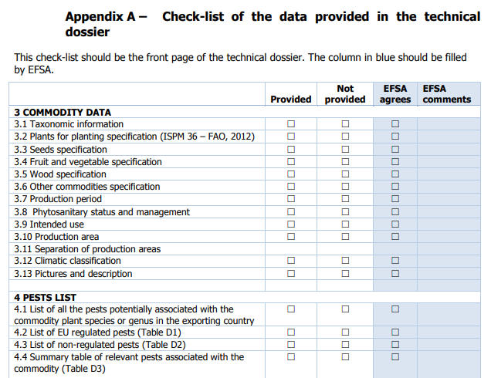

Dossier on fruits of Momordica L.
The dossier is composed of two main sections:
Commodity description
Risk mitigation measures
Refer to Section 3 and 5 of the Technical Report (TR)
(EFSA, 2018)
Checklist: first page of the dossier
Do not miss it!
6
Notes:
As for the other HRP, when compiling the dossier for fruits of Momordica you need to follow the TR published by EFSA. The dossier will be composed of two main sections that we will see in detail in a few mins, one section reporting the commodity description (section 3 of the TR) and a second part on risk mitigation measures (section 5 of the TR). What is different from the other HRP commodities, is that in this case you do not have to compile a pest list since the only relevant pest in the case of Momordica is Thrips palmi. In the check list, you will just need to tick “not provided” to all the paragraphs related to the pest list.
Do not forget to include the check list at the beginning of your dossier.

Slide 7
a. Commodity data: TR Section 3
  Scientific name and relevant taxonomic information;
  Description of the commodity (i.e. fruits);
  Production period and phenology;
  General sanitary status and phytosanitary management;
  Intended use of the commodity;
  Map of the production area;
  Köppen-Geiger climate classification;
  Colour pictures with description of the fruits intended to be exported into the EU.
7
Notes:
You need to follow the section 3 of the TR when providing information on commodity data. This includes, for example […]

Slide 8

a. Commodity data
Information has to be
as detailed as possible
to facilitate the assessment of the risk
e.g.
Indicate the period of the year when the commodity is produced and the phenology of the crop.
Describe the general sanitary status and phytosanitary management of the crop in the production area designated for export.
Indicate how you ensure separation between production areas designated for export and other production areas.
8
Notes:
(including sowing/planting, flowering, fruiting and harvesting periods)
If there are differences with other production areas within the country, describe these differences and the reasons for them.
if adjacent to the first ones

Slide 9
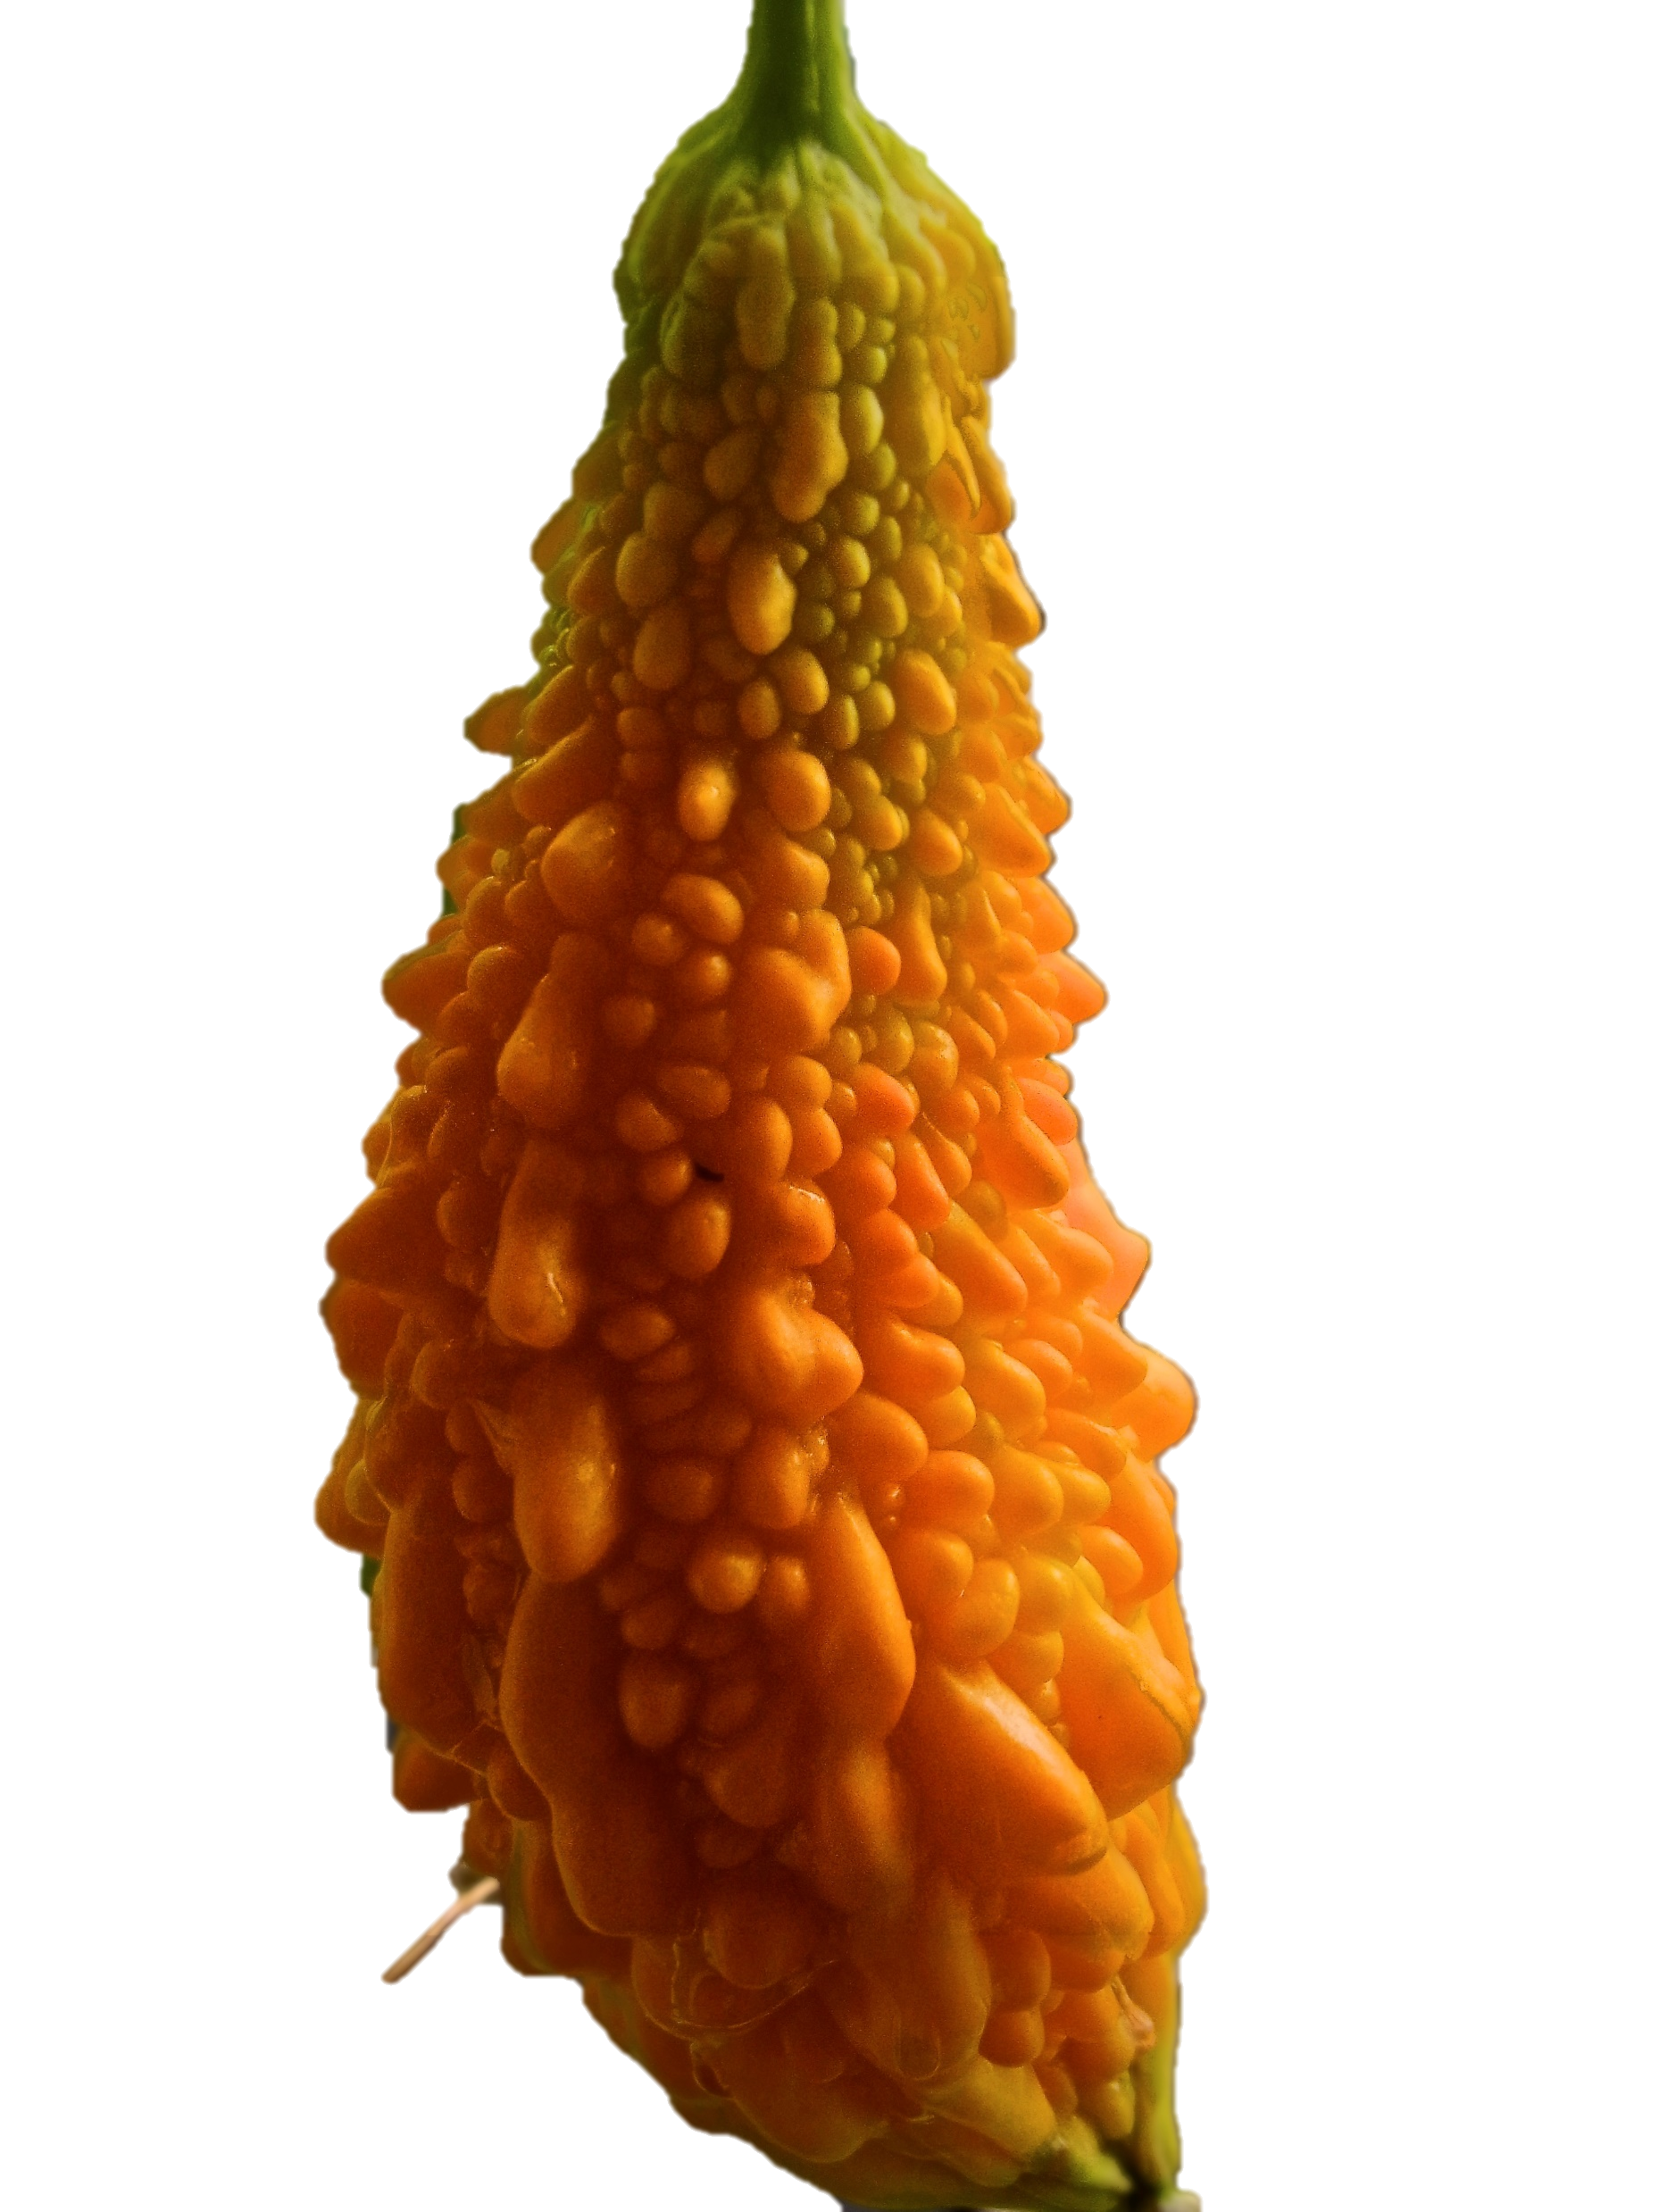
b. Risk mitigation measures for Thrips palmi
  Technical data on the efficacy of risk mitigation measures (pesticides and other measures)
  Certification systems /inspections/ sampling & testing
  Surveillance system
  Handling, packing and export procedure
Refer to Section 5 of the TR (EFSA, 2018)
The information provided has to be supported by evidence!
9

Slide 10
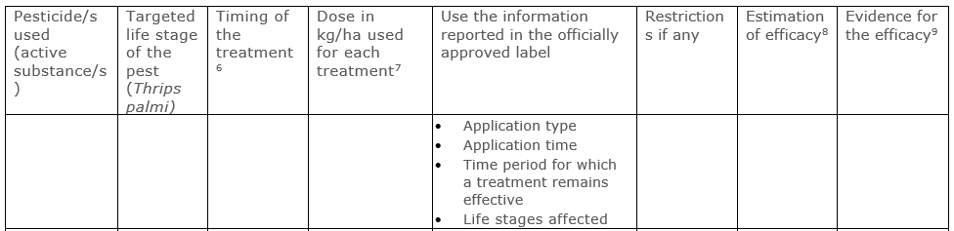

b. Risk mitigation measures for Thrips palmi
e.g.
Describe risk mitigation measures of the commodity and their effectiveness, supported by evidence following Appendix E of the TR (EFSA, 2018).
Indicate phytosanitary regulations and inspection systems related to Momordica L. and associated to Thrips palmi in the country.
Describe surveillance and monitoring systems of T. palmi.
10
Notes:
1. including the ones intended to be applied when exporting the commodity into the EU
3. Describe the post-harvest processes and transport system (from farm to processing and from processing to point of export), including type of packaging material, size of packaging, shipping capacity.

Slide 11

Technical Data on Risk mitigation measures
For insecticide treatment provide:
  estimation and evidence of efficacy against Thrips palmi;
  information on officially approved label;
  active ingredients;
  application type;
  application time;
  dosage for treatment.
11
Notes:
For all the plant protection products used in the production of the commodity all the necessary data has to be provided to demonstrate the effectiveness of the product for the specified pest (which in this case is Thrips palmi only).
We suggest to include all the officially approved label information for each plant protection products used. These include active ingredient, application time and dosage. The information should be provided using table E1 of the TR

Slide 12
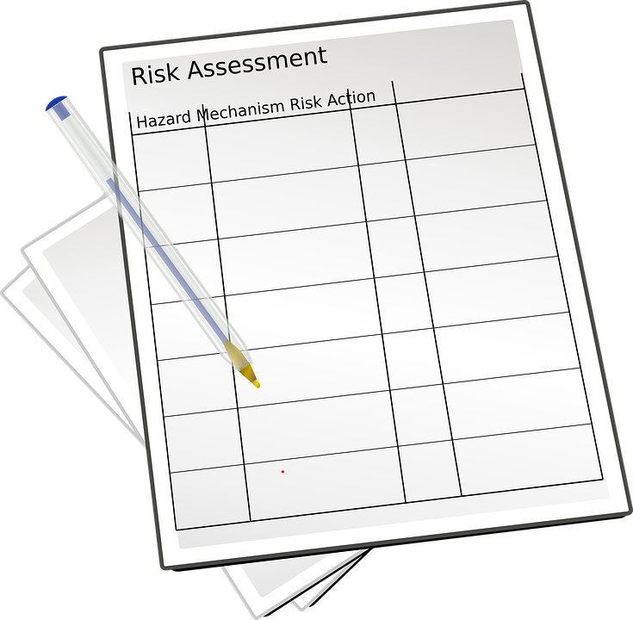
Commodity Risk Assessment
Please include all the information necessary to
assess the risk
Momordica L.
12
Notes:
[take your time in this slide]
we underlying the importance of providing as much information as possible and as detailed as possible in order to help us to perform the commodity risk assessment

Slide 13
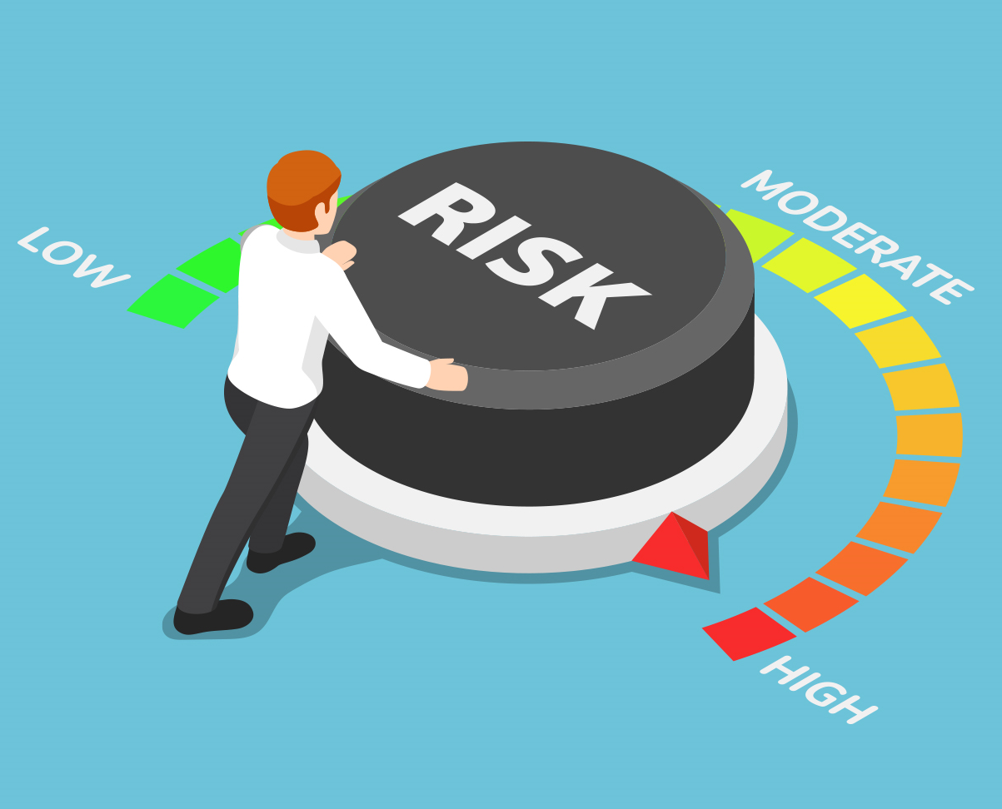
What happens with your dossier
With the information that you provide, EFSA PLH Panel will:
perform an assessment of the efficacy of the risk mitigation measures on Thrips palmi
deliver a scientific opinion on the risk for the EU territory
The European Union (EU) taking into account the RA provided by EFSA will take a decision.
13
Notes:
What is going to happen with the dossier you submit…
EFSA will perform a risk assessment using the information you provided and, and given its advisory capacity of Risk Assessor, will deliver an opinion on the risk posed by the import of the commodity to the EU

Slide 14
Summary/Take home messages
Remember: the aim of the dossier is to support a risk assessment
Before submitting your dossier on Momordica L. check:
You provide data on Momordica L. following Section 3 of the TR
You provide data on risk mitigation measures following Section 5 of the TR
You provide any information relevant to facilitate the risk assessment
The information provided is supported by evidence!
14
Notes:
Additional evidence to be provided include records of interceptions on the exported commodity, evidence to support the assessment of the efficacy of risk mitigation measures as reported in the Appendix E of the TR

Slide 15


Dossier submission
Dossiers (all formats will be accepted) should be sent to the European Commission to:
The Directorate General for Health and Food Safety:
  SANTE-G1-PLANT-HEALTH@ec.europa.eu
Dossier on Momordica L.
15
Notes:
When you submit your dossier, any format will be accepted. You can send for ex. memory stick, pen drive, CD-ROM.
The most common way is to send it as attachment to the email. In any case it would be important to send an index containing the list of the files you are sending in order to be sure everything has been received as you wish.

Slide 16

Q&A session on the Momordica L. dossier
Notes:
Thank you for following us, I will now give back the floor to my colleague Ciro

Slide 17
Thank you to the people behind the scenes
Q&A contributors:
Svetla Kozelska (EFSA - PLH)
Stefano Preti (EFSA - PLH)
Irene Munoz Guajardo (EFSA - AMU)
Nikolaus Kriz, Giuseppe Stancanelli, EFSA PLH team, EFSA CORSER Unit and the European Commission for the support.
Webinar partners:
Francesco Amoretti (CORSER)
Technical operators:
Carla Dall’Aglio (UMAINE)
Felix Badea (UMAINE)
Andrea Magni (UMAINE)
18
Notes:
In case Michela will be there add Michela
Ask for Marella and Alessia, are they involved in the preparation? What about Andrea?

Slide 18
References and useful links
Commission Implementing Regulation (EU) 2018/2019
EFSA Technical Report: Information required for dossiers to support demands for import of high risk plants, plant products and other objects as foreseen in Article 42 of Regulation (EU) 2016/2031
Guidance on commodity risk assessment for the evaluation of high risk plants dossiers
Regulation (EU) 2016/2031 of the European Parliament of the Council
Scientific Opinion on the pest categorisation of Thrips palmi

