Slide 1
17th October 2019
Application of an ad hoc methodology to identify the pests potentially associated with a commodity
Webinar
Notes:
Good morning/afternoon/evening and welcome to all participants of the High Risk Plants Webinars, dedicated to the preparation of a specific section of the technical dossiers, the pest lists, and to the preparation of dossiers for Momordica.
The objectives of this webinar are to provide practical advice to the applicants on how to perform the literature search for the preparation of the pest lists, and how to prepare the technical dossier for Momordica fruits, and when the submission of the dossier is needed.

Slide 2


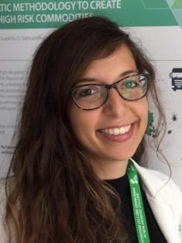
Speakers
Ciro Gardi, EFSA Scientific Officer PLH
Eduardo de la Peña, EFSA Scientific Officer PLH
Maria Chiara Rosace, EFSA Trainee PLH
Notes:
I am Ciro Gardi, scientific officer in the PLH team of EFSA and I am responsible for the coordination of HRP activities. With me on the stage is Eduardo de la Peña and later on Maria Chiara Rosace. Several other colleagues however, that we will acknowledge at the end this 30 minutes session, have contributed to the realization of this webinar.

Slide 3
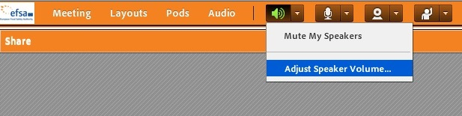
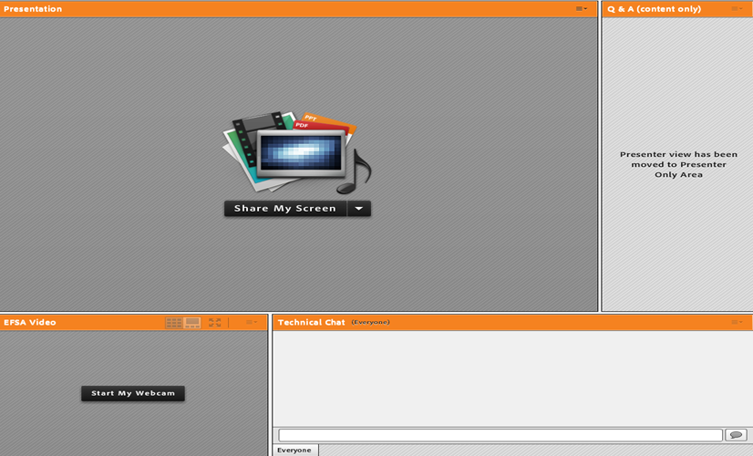

Webinar guide for attendees
This webinar is being recorded!
The webinar is in English and questions should be submitted in English through the platform (see hereunder).
You are automatically connected to the audio broadcast. One-way audio (listen only mode).
Presentation
window
Q&A box: For any questions related to the topic
Notes:
Some technical detail on the structure of the webinar. The webinar will be in English and is being recorded. In the application that you are using to attend the webinar you have a main window, where the presentation is displayed, a window at the bottom of the screen, that is dedicated to technical issues, such as problem of connection, audio, etc. The window at the right side is very important for interacting with us: in this window you can pose questions related to the topic of the webinar. We will try to answer all your questions during the Q&A session, but if the number of questions will be too high for the 10 minutes available, we will provide written answers that will be published on the EFSA website, at the paged edicated to this webinar.

Slide 4
Webinar Outline
Introduction: Regulation (EU) 2016/2031 and High Risk Plant dossiers from non-EU countries
Proposed methodology for the compilation of the pest list
How to prepare a pest list? Webinar 1
Q&A on the proposed methodology
Dossier for fruits of Momordica L. and final Q&A
How to prepare a dossier for Momordica fruits? Webinar 2
4
Notes:
Here is shown the webinar outline. We start with a brief introduction on the new EU Plant Health Law and on the new class of High Risk Plants, describing also how the commodity risk assessment of HRP dossiers will be carried out. Then

Slide 5
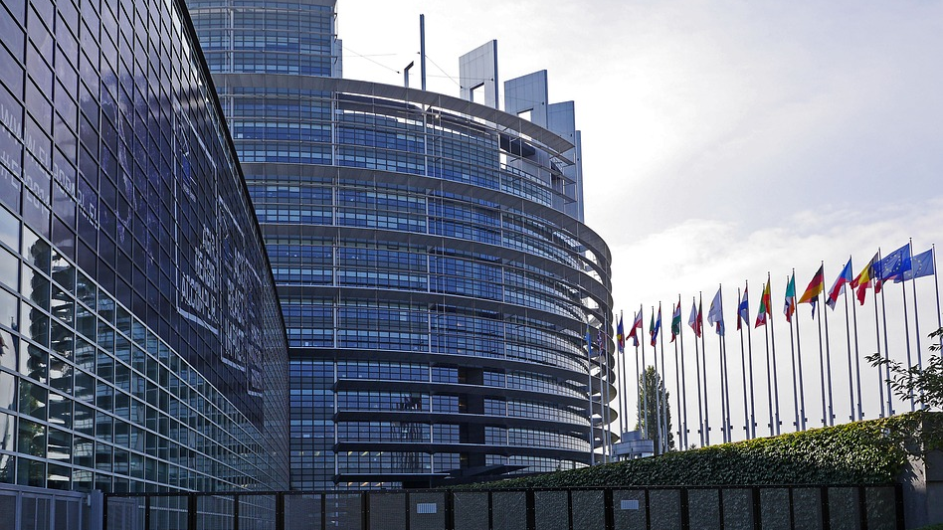

Introduction: Regulation (EU) 2016/2031 and High Risk Plant dossiers from non-EU countries
Notes:
Article 42 of the new EU Plant Health Law (Regulation (EU) 2016/2031) introduces the concept of “High Risk Plants”. This is a group of plants, plant products and other objects whose introduction poses a pest risk of an unacceptable level for the territory of the European Union.

Slide 6
Legislation on High Risk Plants
List of High Risk Plants
Commission Implementing Regulation (EU) 2018/2019
Prohibition from 14 December 2019 pending risk assessment.
Risk assessment (RA)
DOSSIER TO BE SENT BY THE NPPO OF NON-EU COUNTRIES
Commission Implementing Regulation (EU) 2018/2018
Based on the RA, the EU will decide further (i.e. adopt an implementing act for the commodity)
e.g. specific measures or prohibition
Decision
6
Notes:
A provisional list of high risk plants was published on 18 December 2018. For these high risk plants an import prohibition will be introduced, being effective from 14 December of this year.. The National Plant Protection Organisations from third countries can request a lift from this import prohibition by submitting a technical dossier to the European Commission. This technical dossier is the basis of the risk assessment of the specific commodity that will be carried out by EFSA. On the base of this Risk Assessment the Commission will decide if maintain or withdraw the ban for the applicant country or to adopt specific measures.

Slide 7

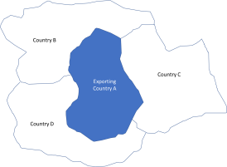





Commodity Risk Assessment Procedure
Additional information
required
Applicant Country
Commodity RA
published
Dossier
7
Notes:
In this slide are shown the different steps of the process. The non-EU county interested in exporting into the EU one of the commodity listed as High Risk Plant prepare a dossier, and we will explain shortly how this should be done, and send the dossier to the EC (instructions will be provided at the end of the presentation). The EC perform an administrative and a preliminary formal completeness check, and then transfer the dossier to EFSA. EFSA has established a dedicated WG that will perform the Commodity Risk Assessment according to the instructions that are described in a Guidance that was published in April of this year. The result of the RA are sent back to the EC, that as RM will be in charge of the final decision.
As you can see there are several arrow that are pointing back to the third country, because in case on uncomplete dossiers/lack of information, a request of integration of information will be sent back to the applicant. In these possible cases the clock will be stopped, and this will cause delay in the RA.

Slide 8

Proposed methodology for the compilation of a pest list
Notes:
All the information that can help us to assess the risk

Slide 9
Methodological aspects
Methodology explained in EFSA Technical Report
Information required for dossiers to support demands for import of High Risk Plants, plant products and other objects as foreseen in Article 42 of Regulation (EU) 2016/2031
Dossier should:
Present commodity data
Identify all pests potentially associated with the commodity in the exporting country
Data on risk mitigation measures
9

Slide 10
Methodological aspects
Methodology explained in EFSA Technical Report
Information required for dossiers to support demands for import of High Risk Plants, plant products and other objects as foreseen in Article 42 of Regulation (EU) 2016/2031
Dossier should:
Present commodity data
Identify all pests potentially associated with the commodity in the exporting country
Data on risk mitigation measures
Appendix A, B, C, D, E
10

Slide 11
Objective of this webinar
Help NPPOs to prepare the dossiers for the EC regarding High Risk Plants:
How to prepare a pest list?
11

Slide 12






Objective of this webinar
How to compile a list of pests potentially associated with the commodity in a given country
Insects and mites
Plant parasitic nematodes
Pathogenic fungi and bacteria
Viruses and phytoplasma
Any other organism posing a threat
12

Slide 13
Compiling a pest list
Dossiers are prepared at species level
Search for pests/diseases at species level
e.g. Quercus robur
Might use search strategy proposed by EFSA
Search outputs
Give full reference to retrieved pest/diseases
Refer to the database where the info was found
13
Notes:
Strings to be changed with strategy

Slide 14
Compiling a pest list
Under two possible scenarios:
Access to commercial databases e.g.:
EPPO Global Database
CAB Abstracts
CABI CPC
Web of Science
Scopus
No acces to commercial databases:
Use of free databases
EPPO Global Database
Google scholar
Open databases
PubMed
14

Slide 15
Compiling a pest list
Some examples of potential search strings:
Quercus robur AND insect pests
Quercus robur AND mites
Quercus robur AND diseases
Quercus robur AND pathogenic fungi
Quercus robur AND pathogenic bacteria
Quercus robur AND viruses
Quercus robur AND insect pests AND Country/Region
(You may consider narrowing your search to a certain country or region)
15

Slide 16
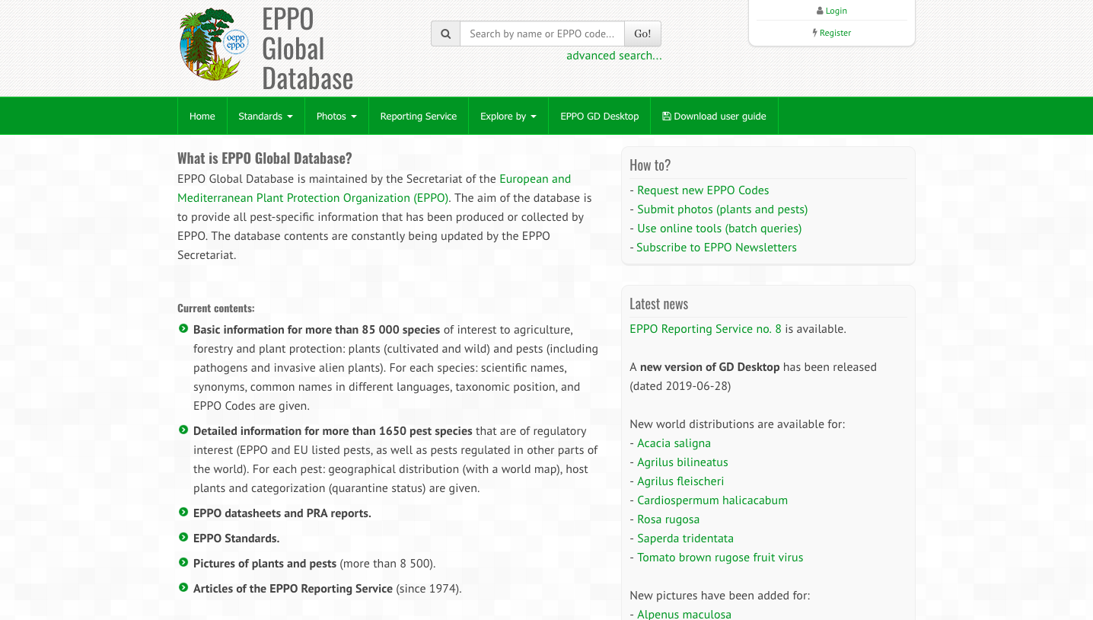
Compiling a pest list
Go to https://gd.eppo.int/
16

Slide 17
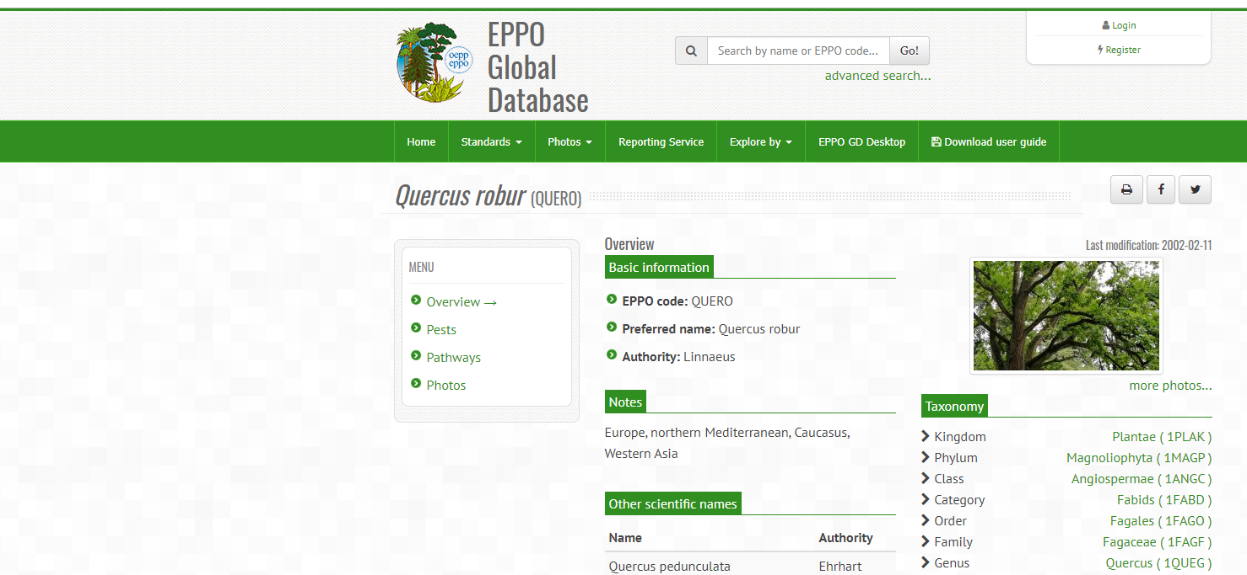
Compiling a pest list
1. Search by plant species name or EPPO code
2. Go to the list of pests associated to that species
3. Retrieve pests and diseases
17

Slide 18
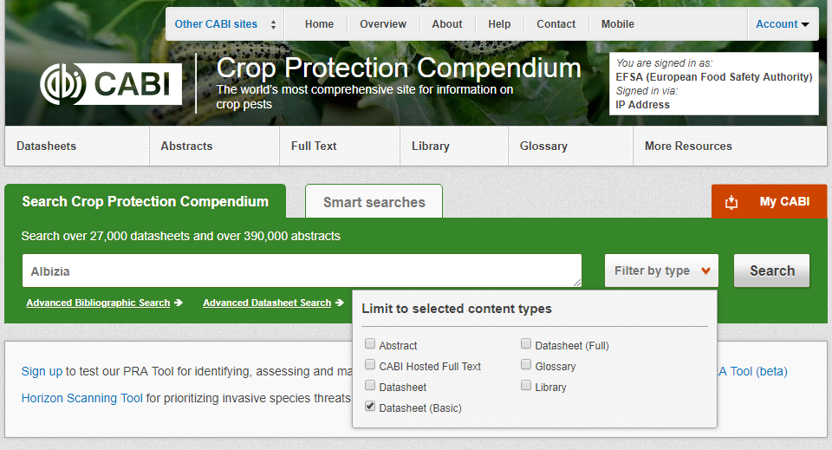
Compiling a pest list: commercial databases
Search for species on the Crop Protection Compendium, selecting just basic and full datasheets
Check for pests/diseases in the datasheet
Retrieve pests and diseases, add them to your dossier.
Go to https://www.cabi.org/publishing-products/compendia/crop-protection-compendium/
18

Slide 19
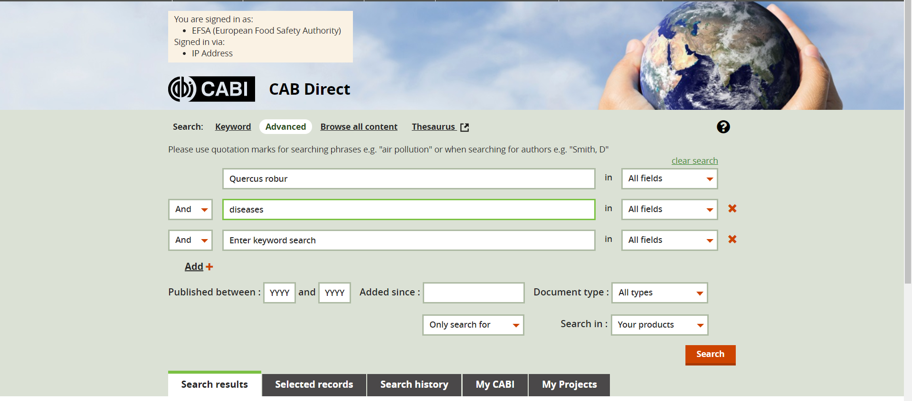
Compiling a pest list: commercial databases
Go to https://www.cabdirect.org/
19

Slide 20
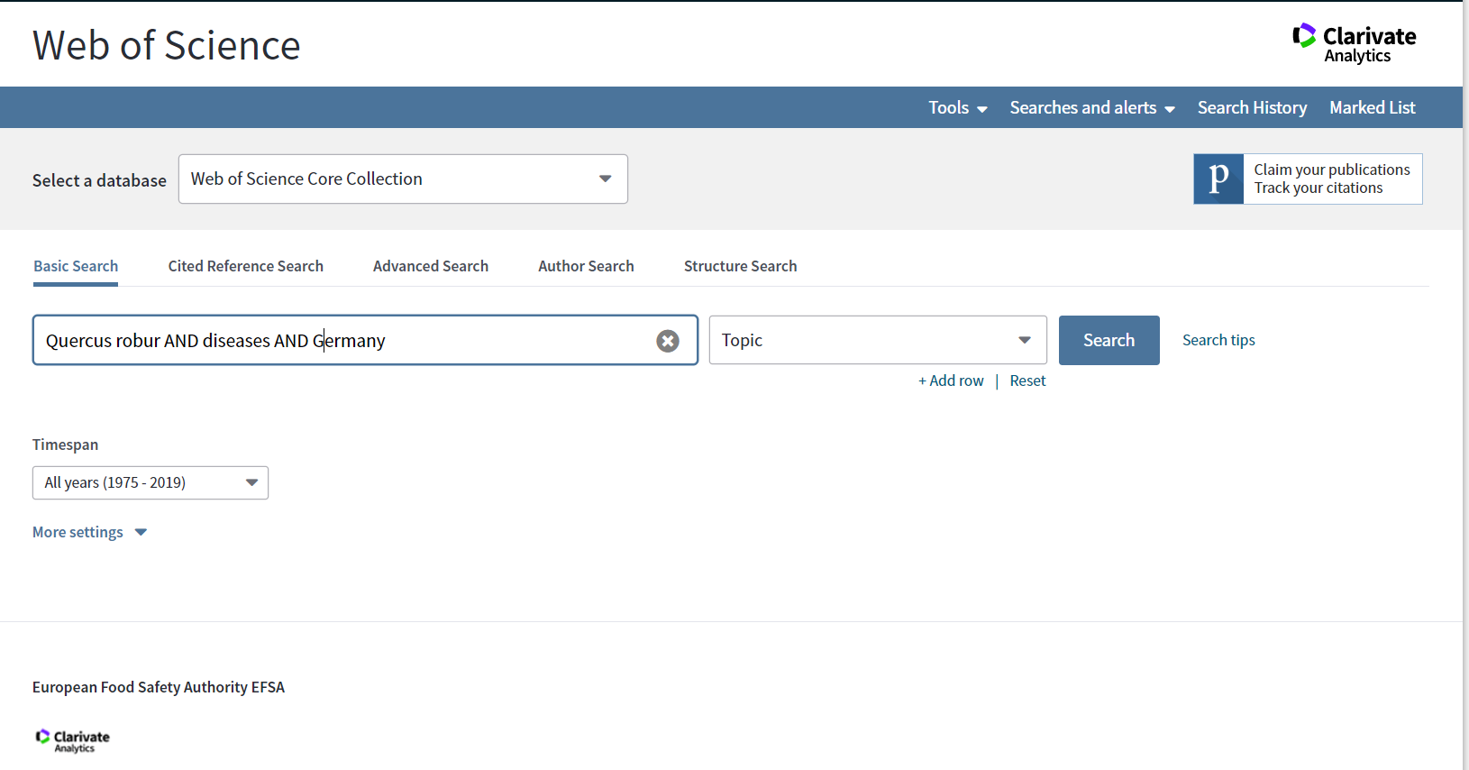
Compiling a pest list: commercial databases
Got to https://www.webofknowledge.com
20

Slide 21
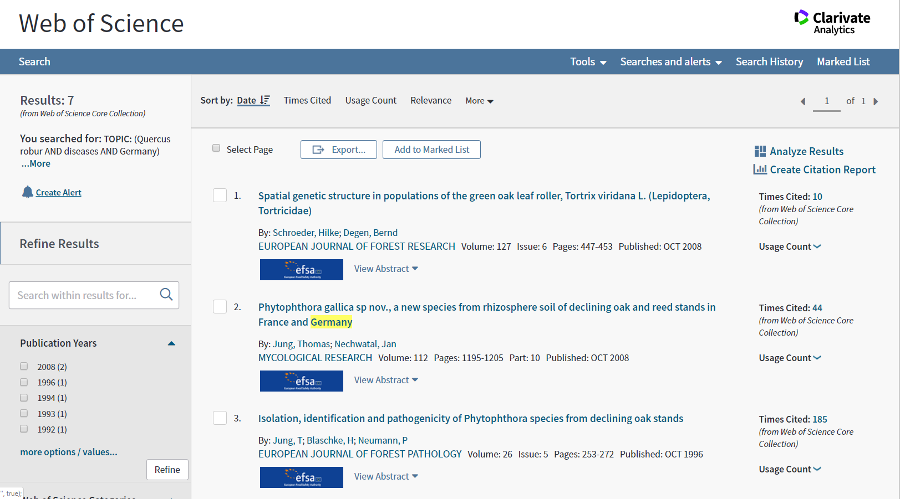
Compiling a pest list: commercial databases
21

Slide 22
Main tasks
Compile pest list associated to the commodity in a given country
Insects and mites
Plant parasitic nematodes
Pathogenic fungi and bacteria
Viruses and phytoplasma
Any other organism posing a threat
22

Slide 23
Compiling a pest list: open access databases
Go to https://gd.eppo.int/
23
Notes:
We changed “no access databases” to “open access databases”

Slide 24
Compiling a pest list: open access databases
1. Search by plant species name or EPPO code
2. Go to the list of pests associated to that species
3. Retrieve pests and diseases
24

Slide 25

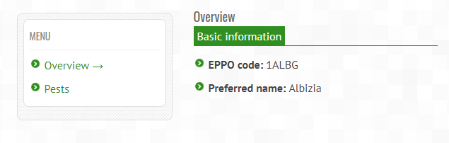
Compiling a pest list: open access databases
1. Search by plant species name or EPPO code
2. Go to the list of pests associated to that species
3. Retrieve pests and diseases
25

Slide 26
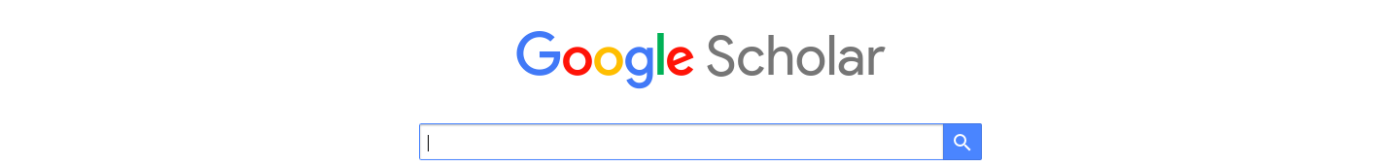
Compiling a pest list: open access databases
Go to https://scholar.google.com/
26

Slide 27
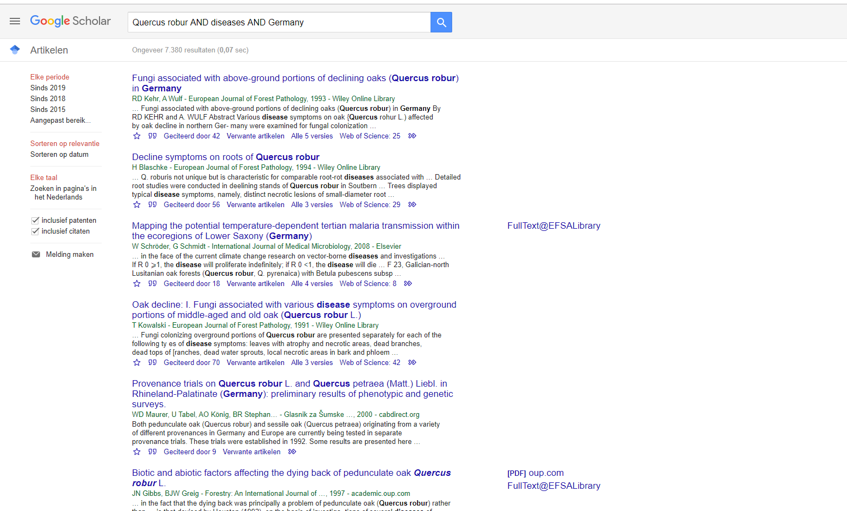
Compiling a pest list: open access databases
27

Slide 28
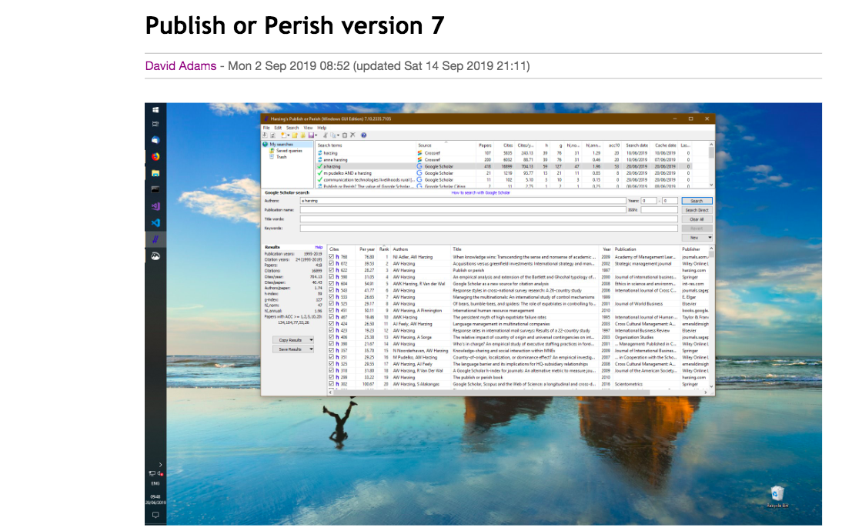
Compiling a pest list: open access databases
Software to manage references coming from Google Scholar
Go to https://harzing.com/resources/publish-or-perish
28

Slide 29
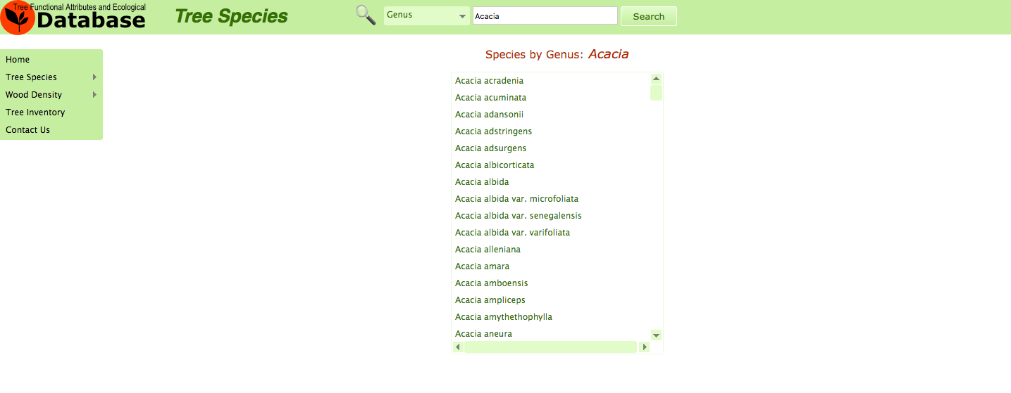
Compiling a pest list: open access databases
Go to http://old.worldagroforestry.org/treedb/index.php?speciesname=A
29

Slide 30
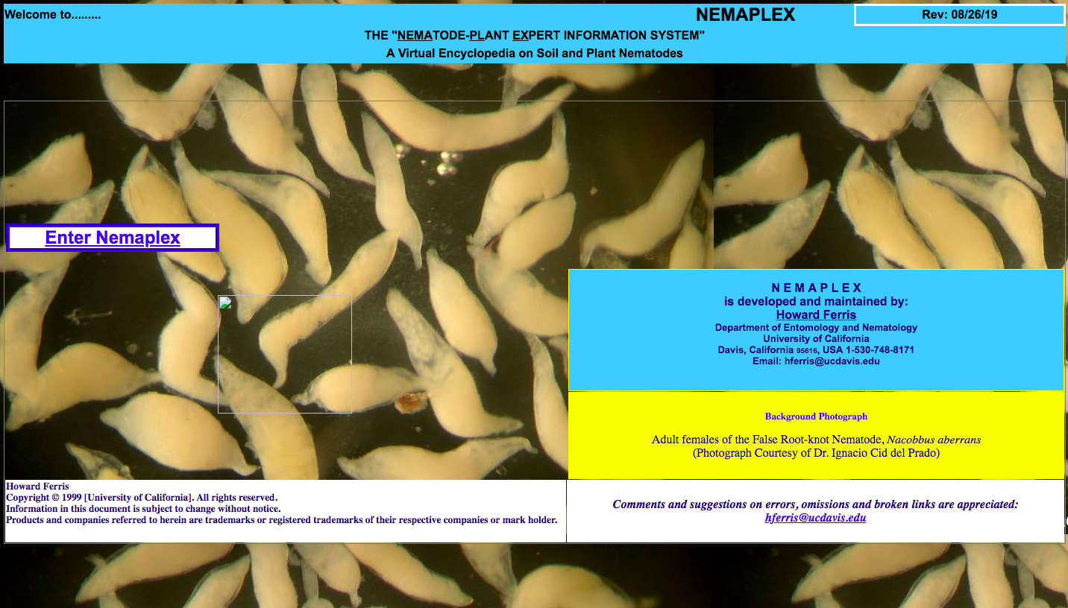
Compiling a pest list: open access databases
Go to http://nemaplex.ucdavis.edu/
30

Slide 31
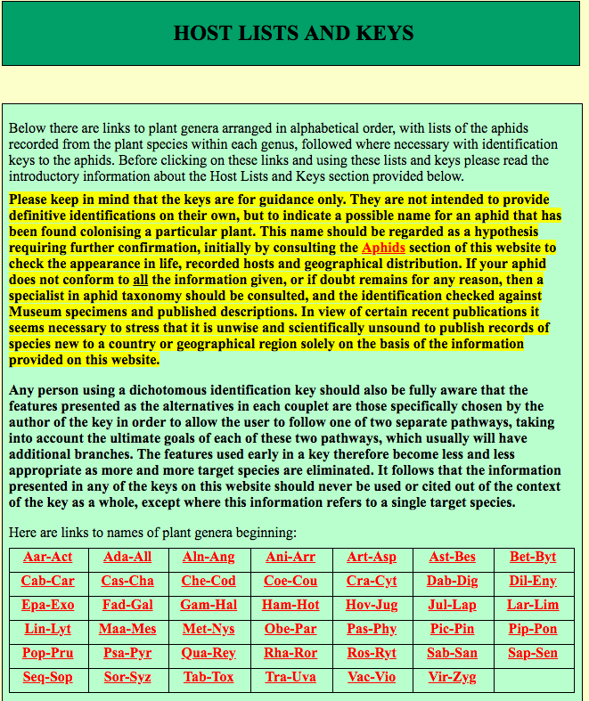
Compiling a pest list: open access databases
Go to http://www.aphidsonworldsplants.info/C_HOSTS_AAIntro.htm
31

Slide 32
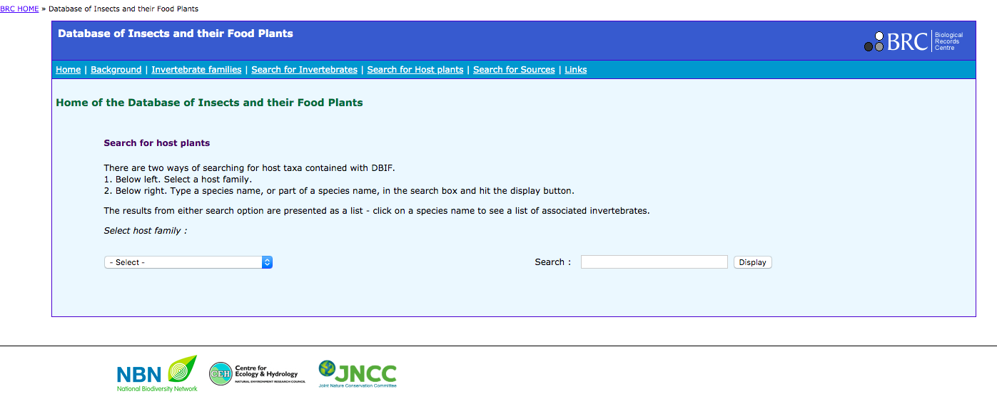
Compiling a pest list: open access databases
Go to http://www.brc.ac.uk/dbif/
32

Slide 33
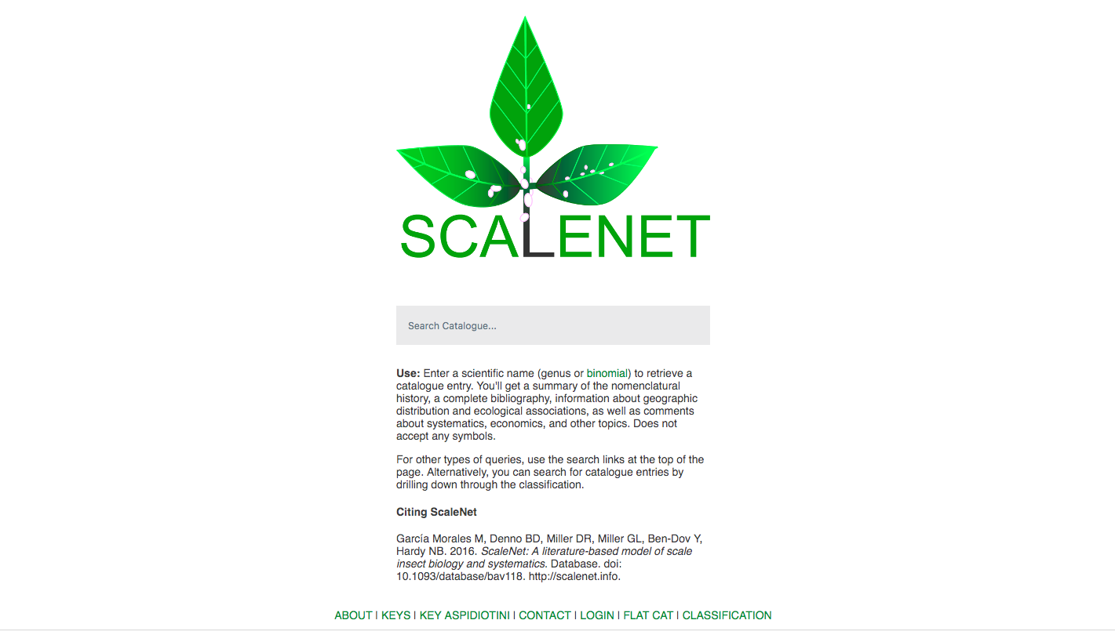
Compiling a pest list: open access databases
Go to http://scalenet.info/
33

Slide 34
Final considerations
Recommendations
Keep track of search methodology
Date, keywords and search terms
Explain methodology used for the pest list compilation
Databases (CABI, EPPO, others)
References
Give full reference to the pests and diseases reported
Organize output as specified in the EFSA Technical Report
Provide all information relevant to help us to evaluate properly your dossier
34
Notes:
Give full reference to the pests and diseases reported → is this sentence clear enough? Let’s discuss about it
What do we understand when we say “give full reference”?

Slide 35

Hold on!
We will be back in 10 minutes following the Q&A session on the proposed methodology

