Slide 1


Some industry perspectives
Short overview of the application process for regulated products
Main phases
Importance of timelines
Additional feedback
EFSA Stakeholder forum – November 2023
Notes:
The Practical Arrangements are binding means to interpret and implement the legal framework provided by the Transparency Regulation
By specifying the details for the implementation of required processes, they commit to how the Transparency Regulation will be applied by EFSA

Slide 2
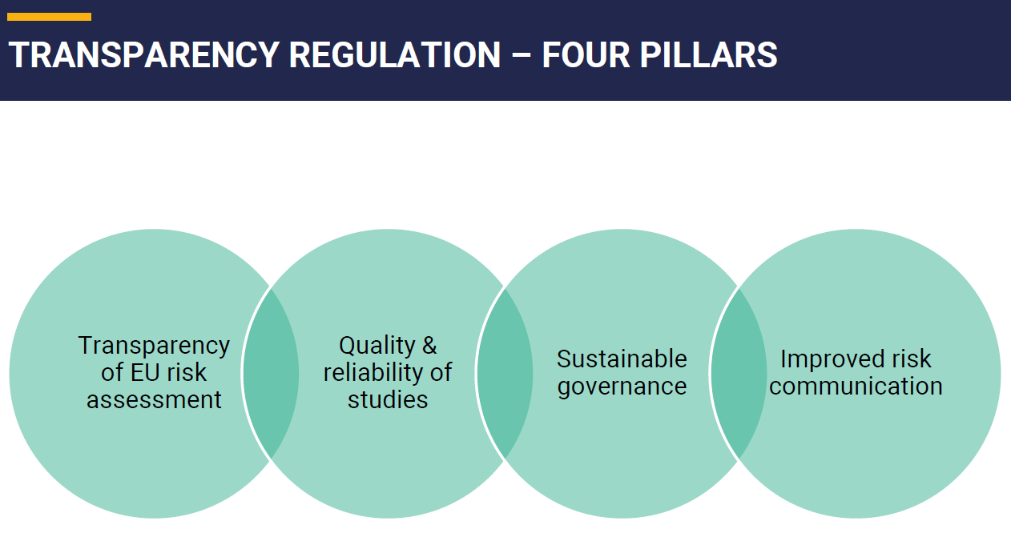
The industry fully supports the TR pillars
Can EFSA provide statistics ?
There is appreciation on the efforts by EFSA to cope with the considerable set of new tasks

Slide 3
About sustainable governance and TR enforcement
We still see delays on application to come through the entire process – especially with the confidentiality check step.
Can EFSA provide statistics ?
Average duration of completeness check?
Average duration of a complete risk assessment?
Average duration of a complete application process (per typology)

Slide 4
Application process for regulated products
PRESUBMISSION phase
General pre-submission advice (GPSA - optional)
Notification of studies (in the EFSA portal)
RENEWALS: Notification of studies + “renewal PSA” (mandatory)
SUBMISSION phase & completeness check
Application via EC e-submission portal
EC mandates EFSA
EFSA application completeness check
RISK-ASSESSMENT phase
POST-ADOPTION phase
EFSA publishes the scientific opinion
EC decision on authorisation
EFSA/EC validates the application
EFSA public consultation
EFSA risk assessment
EFSA panel scientific opinion
Increased duration of the application process
Colour code
Applicant
EC
EFSA
Decrease in the number of applications received
30 working days
Some suggestions to optimize the process
May take several months!
Getting a document (sort of Q&A?) with guiding principles would help clarifying what should be expected of such interactions – and how applicants can better prepare internally.
OUR CALL: non committal technical discussion should be possible!
EFSA confidentiality assessment
6 months + RSI
The ESFC platform is not user friendly, it requires to manually upload all the files, their metadata and confidentiality requests have drastically increased the time that is required to file a submission.
it can easily take 4 days!
Notes:
For any renewal this is not important because the product can remain on the market but for a new additive, that means months/years of market access delay.

Slide 5

Application process for regulated products
PRESUBMISSION phase
General pre-submission advice (GPSA - optional)
Notification of studies (in the EFSA portal)
RENEWALS: Notification of studies + “renewal PSA” (mandatory)
SUBMISSION phase & completeness check
Application via EC e-submission portal
EC mandates EFSA
EFSA application completeness check
RISK-ASSESSMENT phase
POST-ADOPTION phase
EFSA publishes the scientific opinion
EC decision on authorisation
EFSA/EC validates the application
EFSA public consultation
EFSA risk assessment
EFSA panel scientific opinion
Some suggestions to optimize the process
1
Confidentiality claims take up most of the time for dossier preparation. List of legal grounds should be extended as now there are gaps (i.e., methods developed by third parties).
CALL for more EFSA human resources
30 working days
EFSA confidentiality assessment
1
6 months + RSI
2
The EFSA risk assessment duration may heavily be affected by Requests for Supplementary Information which in certain cases could be prevented
CALL for systematic Technical Hearings
2
3
3
Adoption of opinions only take place after Scientific panel meetings => opinions may arrive weeks/months later than the legal evaluation deadline (labelled as a legal deadline in ESFC).
This is confusing.
Clarify circumstances please
Notes:
For any renewal this is not important because the product can remain on the market but for a new additive, that means months/years of market access delay.

Slide 6
Additional feedback
Extension of the catalogue of services
Having an extension of the catalogue to systematically offer to applicants to have a Technical Hearing / Hearing Expert option on their application with the WG/Panel.
It would allow to provide basic information on the context of the application, with the aim to prevent as much as possible ‘waste time’ questions in the course of the assessment.
Update welcome but there are still few questions
In the study types to be notified, added reference to efficacy studies – however it is not applicable to all sectors (e.g., PPPs)
What is the impact of the clarifications added to existing cases of applications being terminated due to non-compliance with the notification of study obligation ? (e.g., analytical results now exempted)

Slide 7
Criteria for triggering certain transparency actions
It remains unclear to applicants why certain opinions will undergo a public consultation and some not before final adoption (e.g., health-based values for copper)
Similarly for certain opinions being shared ‘under embargo’ and others not.
→ Can EFSA clarify what are the criteria for such decisions ?

Slide 8
Other important elements
The IT infrastructure is improving a lot but there are still technical concerns
E.g., submission for novel food applications have still a certain file size limit.
A panel selected to assess an application should ideally stay stable over the life cycle of the application in EFSA
OpenEFSA is improving but we are still not at the same level of information/usefulness of the former Register of Questions
Here there might be a difference between applicants needs of the platform and sectorial associations
E.g., EFSA decision to stop the clock (for RSI, etc.), an email is generally sent to the applicant (and this is fine), but the official signed letter in PDF is not visible on the platform (but only in the OpenEFSA factsheet)

Slide 9
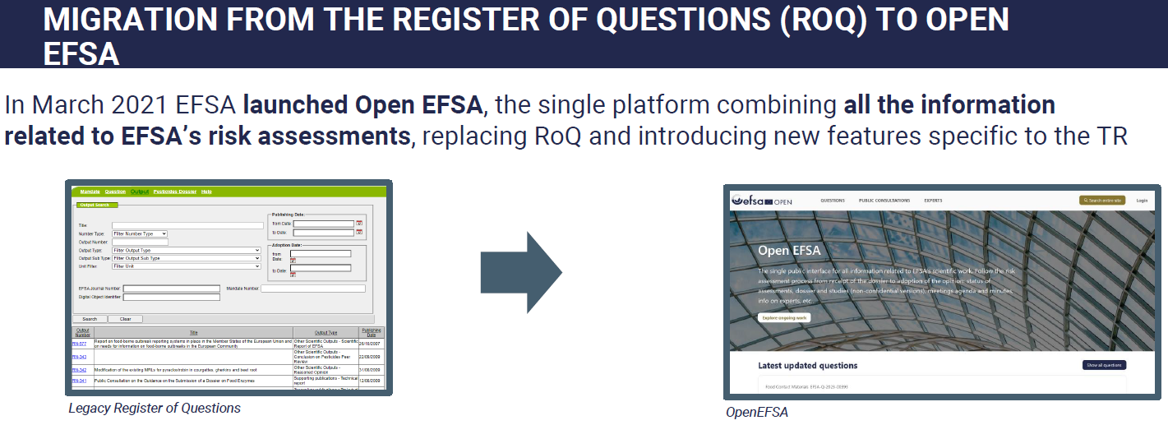
Other important elements
Update?

Slide 10



Additional feedback from stakeholders in the room ?

