Slide 1
13 April 2021
Welcome to the
FEED Technical meeting on FEEDAP guidance on the renewal of the authorisation of feed additives

Slide 2
13 April 2021
FEED Technical meeting on FEEDAP guidance on the renewal of the authorisation of feed additives
Chair: Prof. Vasileios Bampidis
Chair of the FEEDAP Panel

Slide 3
Agenda
Welcome
In-house messages
FEEDAP Guidance on the renewal of the authorisation of feed additives - Novelties and challenges
Questions and answers
Concluding remarks

Slide 4
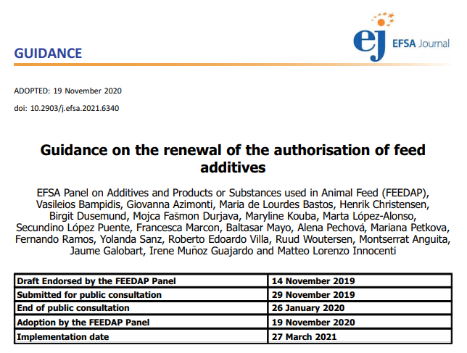
FEEDAP guidance on the renewal of the authorisation of feed additives

Slide 5
13 April 2021
In-house messages
Rosella Brozzi
FEED Unit

Slide 6


In-house messages – some tips
The meeting will be recorded. In case you do not agree, please exit now
Keep your microphone muted and camera off at all times unless specifically asked by the Chair or EFSA staff
If you have problems with the connection, exit the meeting and rejoin. If persist, write to: margherita.olivieri@ext.efsa.europa.eu
Use of headset recommended for better sound quality
Keep the meeting chat box clean. Use it only to write questions and request the floor

Slide 7
In-house messages
Express your interest by writing the question/ comment/“floor please” in the meeting chat box
To allow all attendees to participate, interventions will be limited to 1 per Participant. Further contributions might be granted if time allows
We ask you to send questions following the order of the topics shown in the presentation

Slide 8
Ask questions during the Q&A session, when the Chair grants the floor
When taking the floor turn on your camera (if possible)
Please state your name and affiliation when introducing the question/comment
Keep it simple – short and concise

Slide 9
Enjoy the meeting

Slide 10
13 April 2021
FEEDAP guidance on the renewal of the authorisation of feed additives
Jaume Galobart and Matteo Innocenti
FEED Unit

Slide 11
Some history…
2013
  Guidance on the renewal of the authorisation of feed additives
2016
  Statement on need to update guidance documents
2017
2019
  Identity and characterisation
  Characterisation microorganisms
  Target animal safety
  Consumer safety
  Environment
  Efficacy
2020
  Guidance on the renewal of the authorisation of feed additives
Implementation date: 27 March 2021

Slide 12
Principles of the renewal
Renewal ≠ Re-evaluation
Objectives of the Renewal
the demonstration of compliance of the additive placed in the market with the conditions of the existing authorisation
the demonstration that in the light of the current knowledge, the additive remains safe under the approved conditions for the target species, the consumers, the users and the environment

Slide 13
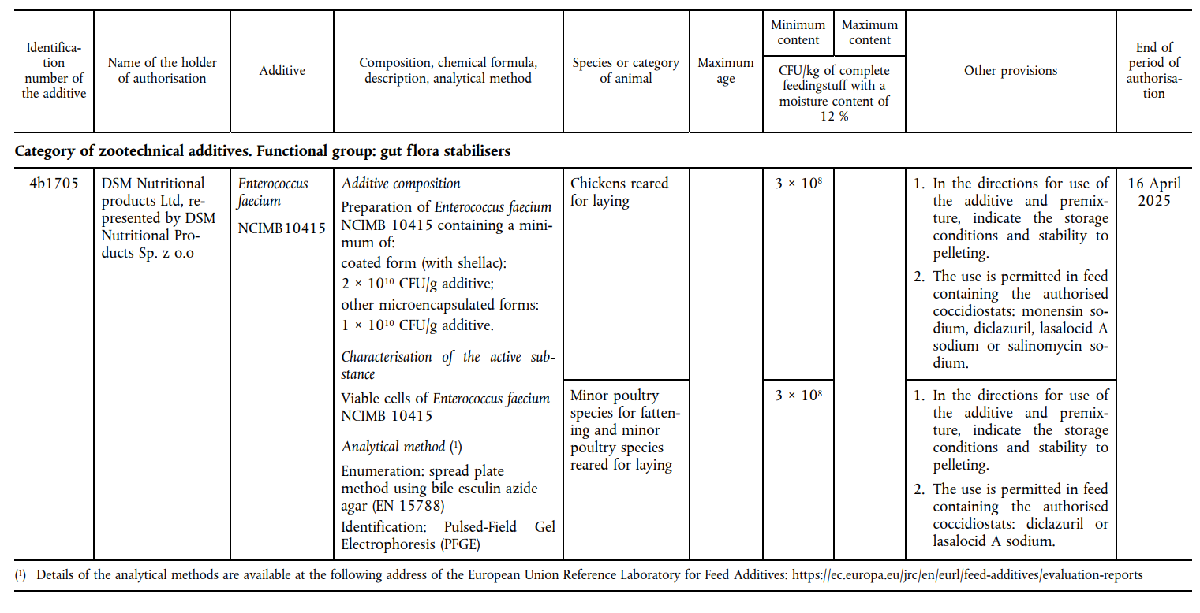
Existing authorisation

Slide 14
Not only renewals…
Joint applications are possible
  Renewal (Art 14)
  New use (Art 4)
  Modification of the authorisation (Art 13)
But…
  Correctly reflected in the application
  Relevant data provided according to the scope of the application (follow applicable guidance documents)

Slide 15
Characterisation
Additive in the market = Additive authorised
Full Section II needed – not necessarily all new data
ALWAYS
If relevant
ALWAYS
Composition/batch to batch
Impurities
Micro-organisms
Relevant changes
Physico-chemical properties
Stability/Homogeneity
CONDITIONS of USE

Slide 16
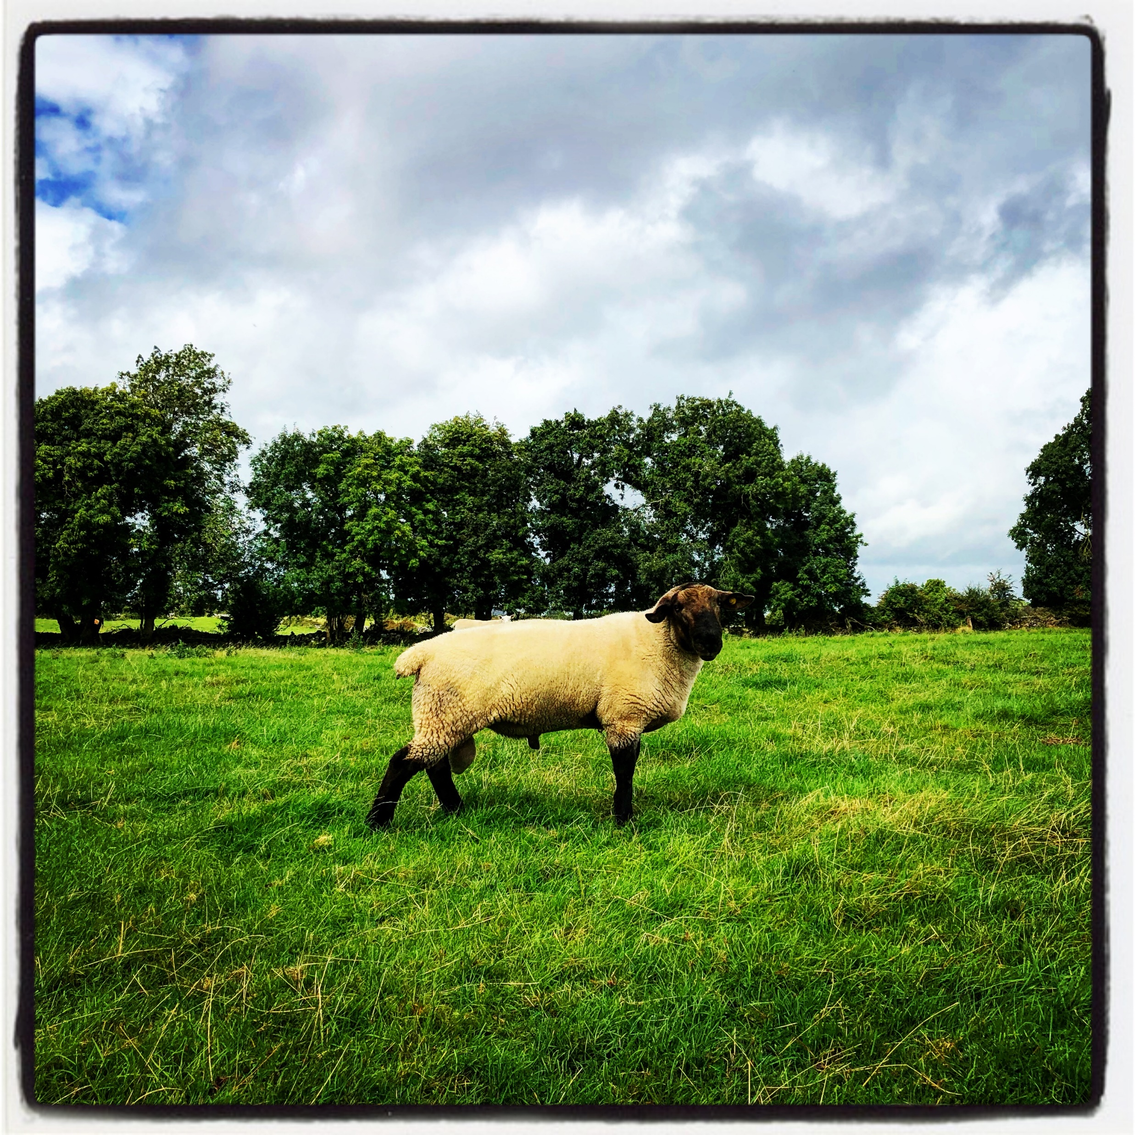
Identity and characterisation

Slide 17
Characterisation
Additive in the market = Additive authorised
Complete Section II needed
Not necessarily all new data

Slide 18
Characterisation – new data needed?
Subject | No changes | Changes composition, manufacturing,…
Qualitative and quantitative composition – batch to batch variation | YES 5 batches | YES 5 batches
Impurities | YES 3 batches | YES 3 batches
Physical state | NO | Depending on change
Characterisation of the active substance active agent(s) (production organisms) | If relevant YES | If relevant YES
Manufacturing process | NO | YES
Stability/Homogeneity | NO | Depending on change
Incompatibilities/interactions | If relevant | If relevant
Conditions of use | If relevant | If relevant

Slide 19
Characterisation - microorganisms
(also for production strains)
Subject | New information needed
Identification (updated nomenclature) | YES
Antimicrobial susceptibility | YES
Antimicrobial production | If not already shown
Toxigenicity and pathogenicity | YES
Description genetic modification | YES/NO
Absence of viable cells | YES
Absence DNA | YES
Compatibility with coccidiostats | NO (if no changes)
Guidance on the characterisation of microorganisms used as feed additives or as production organisms

Slide 20
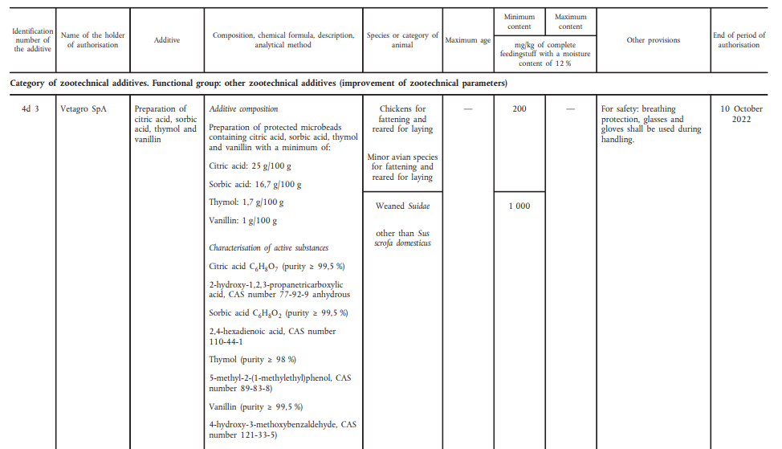
Conditions of use
Same conditions of use proposed
Modification in the conditions of use
Implications for safety and efficacy

Slide 21
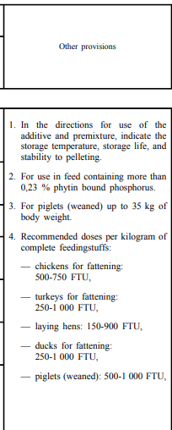
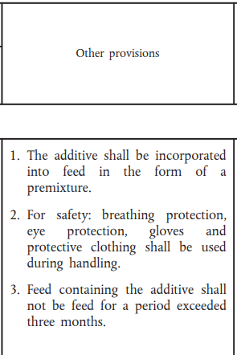
Conditions of use

Slide 22
Main issues so far
Composition/purity
  Data older than 1 year
  Not enough batches analysed
Manufacturing process – no info on changes
Characterisation microorganisms not following new guidance
  Whole genome sequence
  Antimicrobial resistance
  Absence of cells/DNA
Unclear conditions of use
Multiple requests – issues with target species

Slide 23
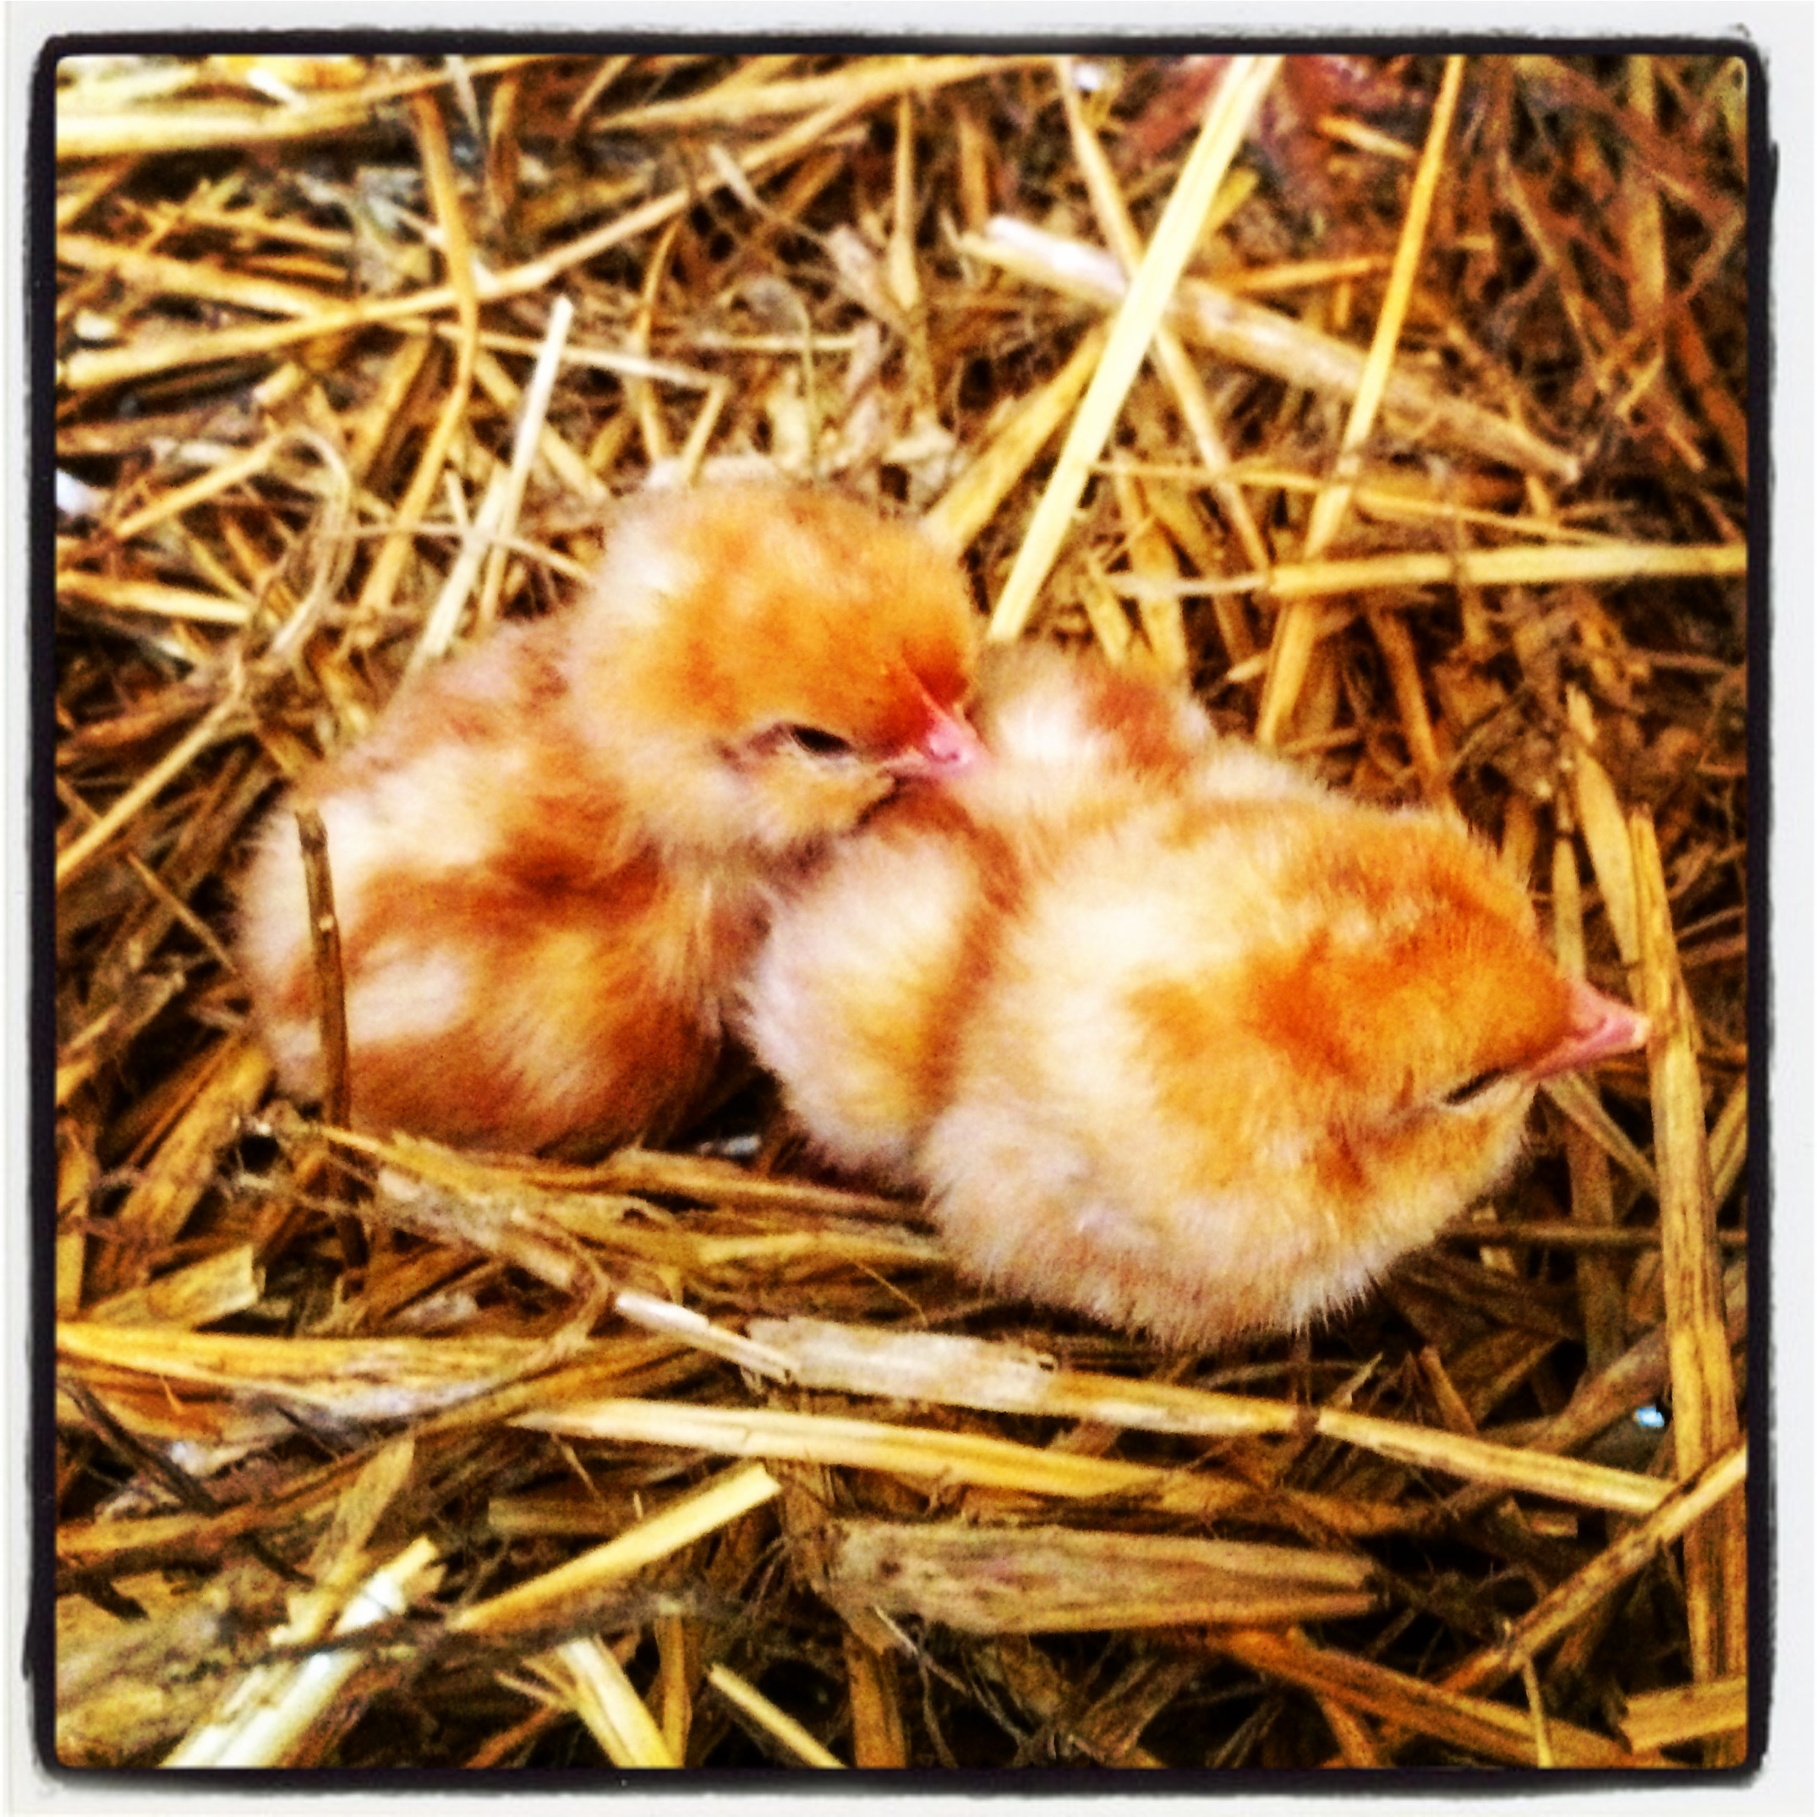
Safety

Slide 24
Safety
Additive in the market → REMAINS safe
Target species, consumers, users and the environment
Update on the safety
Original authorisation /the last renewal → 1 year before the submission
ALWAYS
If available
Post marketing monitoring plan
Reports of any adverse effect
Additional evidence
Quantitative data on production/use of the feed additive
Geographical distribution

Slide 25
Safety – additional evidence
Extensive literature searches
May provide information on the safety of the additive under the authorised conditions of use
should cover at least the period since the last assessment until not more than 1 year before the date of submission of the application for renewal
Additives produced by
fermentation:
production strain(s)
ELS
the active substance(s)/agent(s) in literature studies is (are) identical to that under application
Mixtures:
all the components of the mixture
individually
complete mixture
would still allow conclusions on the additive under application to be made

Slide 26
Safety – additional evidence
Extensive literature searches
Technical manual for performing electronic literature searches in food and feed safety (Glanville et al., 2014)
Aspects to be considered
At least two bibliographic databases (including at least agricultural/ aquacultural and medical/veterinary databases)
Journals, reports, conference proceedings and books
Reference lists of full-text journal articles (e.g.reviews), websites of conferences or organisations
Search terms and search strategy used to ensure the sensitivity of the search
search strings should be broad enough to yield studies on the relevant end-points
should include any specific known (adverse) effects
spelling, abbreviations, identification numbers (CAS number, FLAVIS), generic and brand names of the additive.
boolean operators, truncation, wildcards or proximity operators

Slide 27
Safety – additional evidence
Extensive literature searches
Reporting
Database searches
the name of the database and the service provider used
the date of the search and the date range searched
any limits placed on the search such as language or publication status
the full search strategy (all terms and set combinations) and the number of records retrieved

Slide 28
Safety – additional evidence
Extensive literature searches
Reporting
Websites and journal table of contents
name of the resource / URL
date of the search and date range searched / dates, volumes and issues for table of contents
method of searching, (browsing, using the search engine or scanning tables)
any limits applied to the search (e.g. publication types)
search terms used / number of relevant summary records or full-text
References lists
the bibliographic details of the documents whose reference lists were scanned
the number of relevant bibliographic references retrieved

Slide 29
Safety – additional evidence
Extensive literature searches
Reporting
Information concerning the selection of publications
exclusion/inclusion criteria
number of papers reviewed and excluded papers
bibliographic references for all relevant publications selected /the unobtainable publications
Summary table of the outcome of the selection process
information on the test item (and relation with the product under assessment)
concentration/doses, animal species, duration
end-points assessed
summary of the effects observed
Critical assessment of the evidence collected

Slide 30
Main issues so far - additional evidence
ELS
Time span of the ELS not adequate
  Not covering the time since the last authorisation
  Finished more than 1 year before submission
Characterisation of the additive not complete
  Trade name not included
  Synonyms not included
  Only part(s) of the mixture included
  Reporting not complete
  Terms, combinations…
  Safety sections not included
  User safety, environment…

Slide 31
Safety – additional evidence
New studies
To cover any aspects of the safety of the additive (and efficacy)
should
be completed within the 3 years before the submission
reflect the current EU farming/production conditions
be performed and reported according to the relevant guidance documents

Slide 32
Safety – target animals
Additional evidence
Specific aspects to be considered
Section 2 of the Guidance on the assessment of the safety of feed additives for the target species | No additional information required
Additives for all animal species for which safety was derived from studies in three terrestrial major species | Evidence should be provided that the additive is safe for fish (salmonids)
Additives for which a maximum safe concentration in feed was derived using the results of repeated dose toxicity studies in laboratory animal | Verify whether different no observed adverse effect level (NOAEL) or benchmark dose level (BMDL) are available
 | New calculation of the maximum safe concentration in feed if lower NOAEL or BMDL are identified

Slide 33
Safety – target animals
Additional evidence
Specific aspects to be considered
Composition/manufacturing process affecting the physico-chemical properties of the additive (effects on bioavailability of the active substance) | Implications on the safety for the target species should be addressed
Knowledge or evidence of adverse effects of the additive in the target species | Effects should be specifically addressed Potential implications on the conditions of use of the additive considered

Slide 34
Safety – consumer
Additional evidence
Any new data/information available on:
absorption, distribution, metabolism and excretion (ADME) and deposition,
toxicological properties of the additive or its components in the target species or laboratory animals,
exposure of the consumer to residues.
Section 3.1 of the Guidance on the safety of the consumer
No additional information to support the safety for the consumer is required

Slide 35
Safety – consumer
Additional evidence
Specific aspects to be considered
Residues | Authorising Regulation requiring residue monitoring
 | Metabolism in the target species ≠ set of metabolites/residues compared to that already evaluated
 | Modifications in the composition/manufacturing (effects on bioavailability of the active substance)
 | Any additives for which a health-based guidance value (HBGV) is established

Slide 36
Safety – consumer
Additional evidence
Specific aspects to be considered
Toxicological data | New information available regarding the toxicological and pharmacological properties of the additive (in laboratory and target animals and in humans)
 | Assessments of the active substance(s)/additive from any scientific international bodies (e.g. reassessing HBGV)

Slide 37
Safety – consumer
Additional evidence
Specific aspects to be considered
Genotoxicity | UDS test no longer recommended as an in vivo follow-up to positive results in in vitro gene mutation tests → positive results: are considered adequate → negative results: reliability and significance evaluated in a weight of evidence approach more sensitive tests could be necessary
 | In vivo genotoxicity test with negative results → evidence of target tissue exposure

Slide 38
Safety – consumer
Additional evidence
Specific aspects to be considered
Genotoxicity Chemical mixtures | Fully defined mixtures Component-based approach → all available information Read across Quantitative structure-activity relationship (QSAR)
 | Substantial fraction of undefined substances Chemically defined substances → assessed individually for potential genotoxicity Experimental testing of the unidentified fraction (if not feasible → whole)

Slide 39
Safety – consumer
Additional evidence
Exposure
Existing HBGV → consumer exposure should be assessed
Most recent residue data available
Guidance on consumer safety
→ residues in food of animal origin from uses other than as a feed additive
→ the exposure of the consumer to residues of the additive or its metabolites via sources other than food of animal origin

Slide 40
Safety – user
Additional evidence
Specific aspects to be considered
“Real-life" use | Records on adverse effects in complaint management system in the manufacturing plant to persons exposed to the additive
“Classification and labelling” | → Regulation (EC) No 1272/2008 (CLP) → Regulation (EC) 1907/2006 (REACH) → Other regulations
Original data set not complete | Data gaps should be addressed → full data set
Change in the manufacturing | Additional studies may be required changes in exposure (i.e. route and/or extent) potential new hazards introduced

Slide 41
Safety – environment
Additional evidence
Specific aspects to be considered
Specific excluding criteria | Non-food-producing animals only
 | Natural substances already present in feedingstuffs no increase of the concentration in the environment
 | Extensive metabolism and/or rapid degradation
 | Microorganisms qualifying for QPS approach naturally present in soil, plants or animals’ GI tract
Safety demonstrated under the current requirements → new data/information could be required

Slide 42
Main issues so far
No information to support the safety for fish (Absence of evidence is not evidence of absence)
Exposure estimated not considering all the available residues data
  Original (incomplete) dataset for the user safety
  No verification of the compliance of the dataset with the current requirement for the environment risk assessment

Slide 43

Efficacy

Slide 44
Efficacy
Not required for the renewal of the authorisation
Amendment of the terms of authorisation
(e.g., reduction of the minimum recommended dose)
Efficacy studies, if needed, in compliance with the current requirements
Additional studies
Coccidiostats Histomonostats | Evidence of maintained susceptibility to the coddiostat/histomonostas Eimeria spp. and Histomonas meleagridis strains
 | Sensitivity studies Strains not older than 3 months at least three sources (origins, farms) of Eimeria/Histomonas strains (mixed infection)
 | Studies should have been completed within the last 2 years before the submission

Slide 45
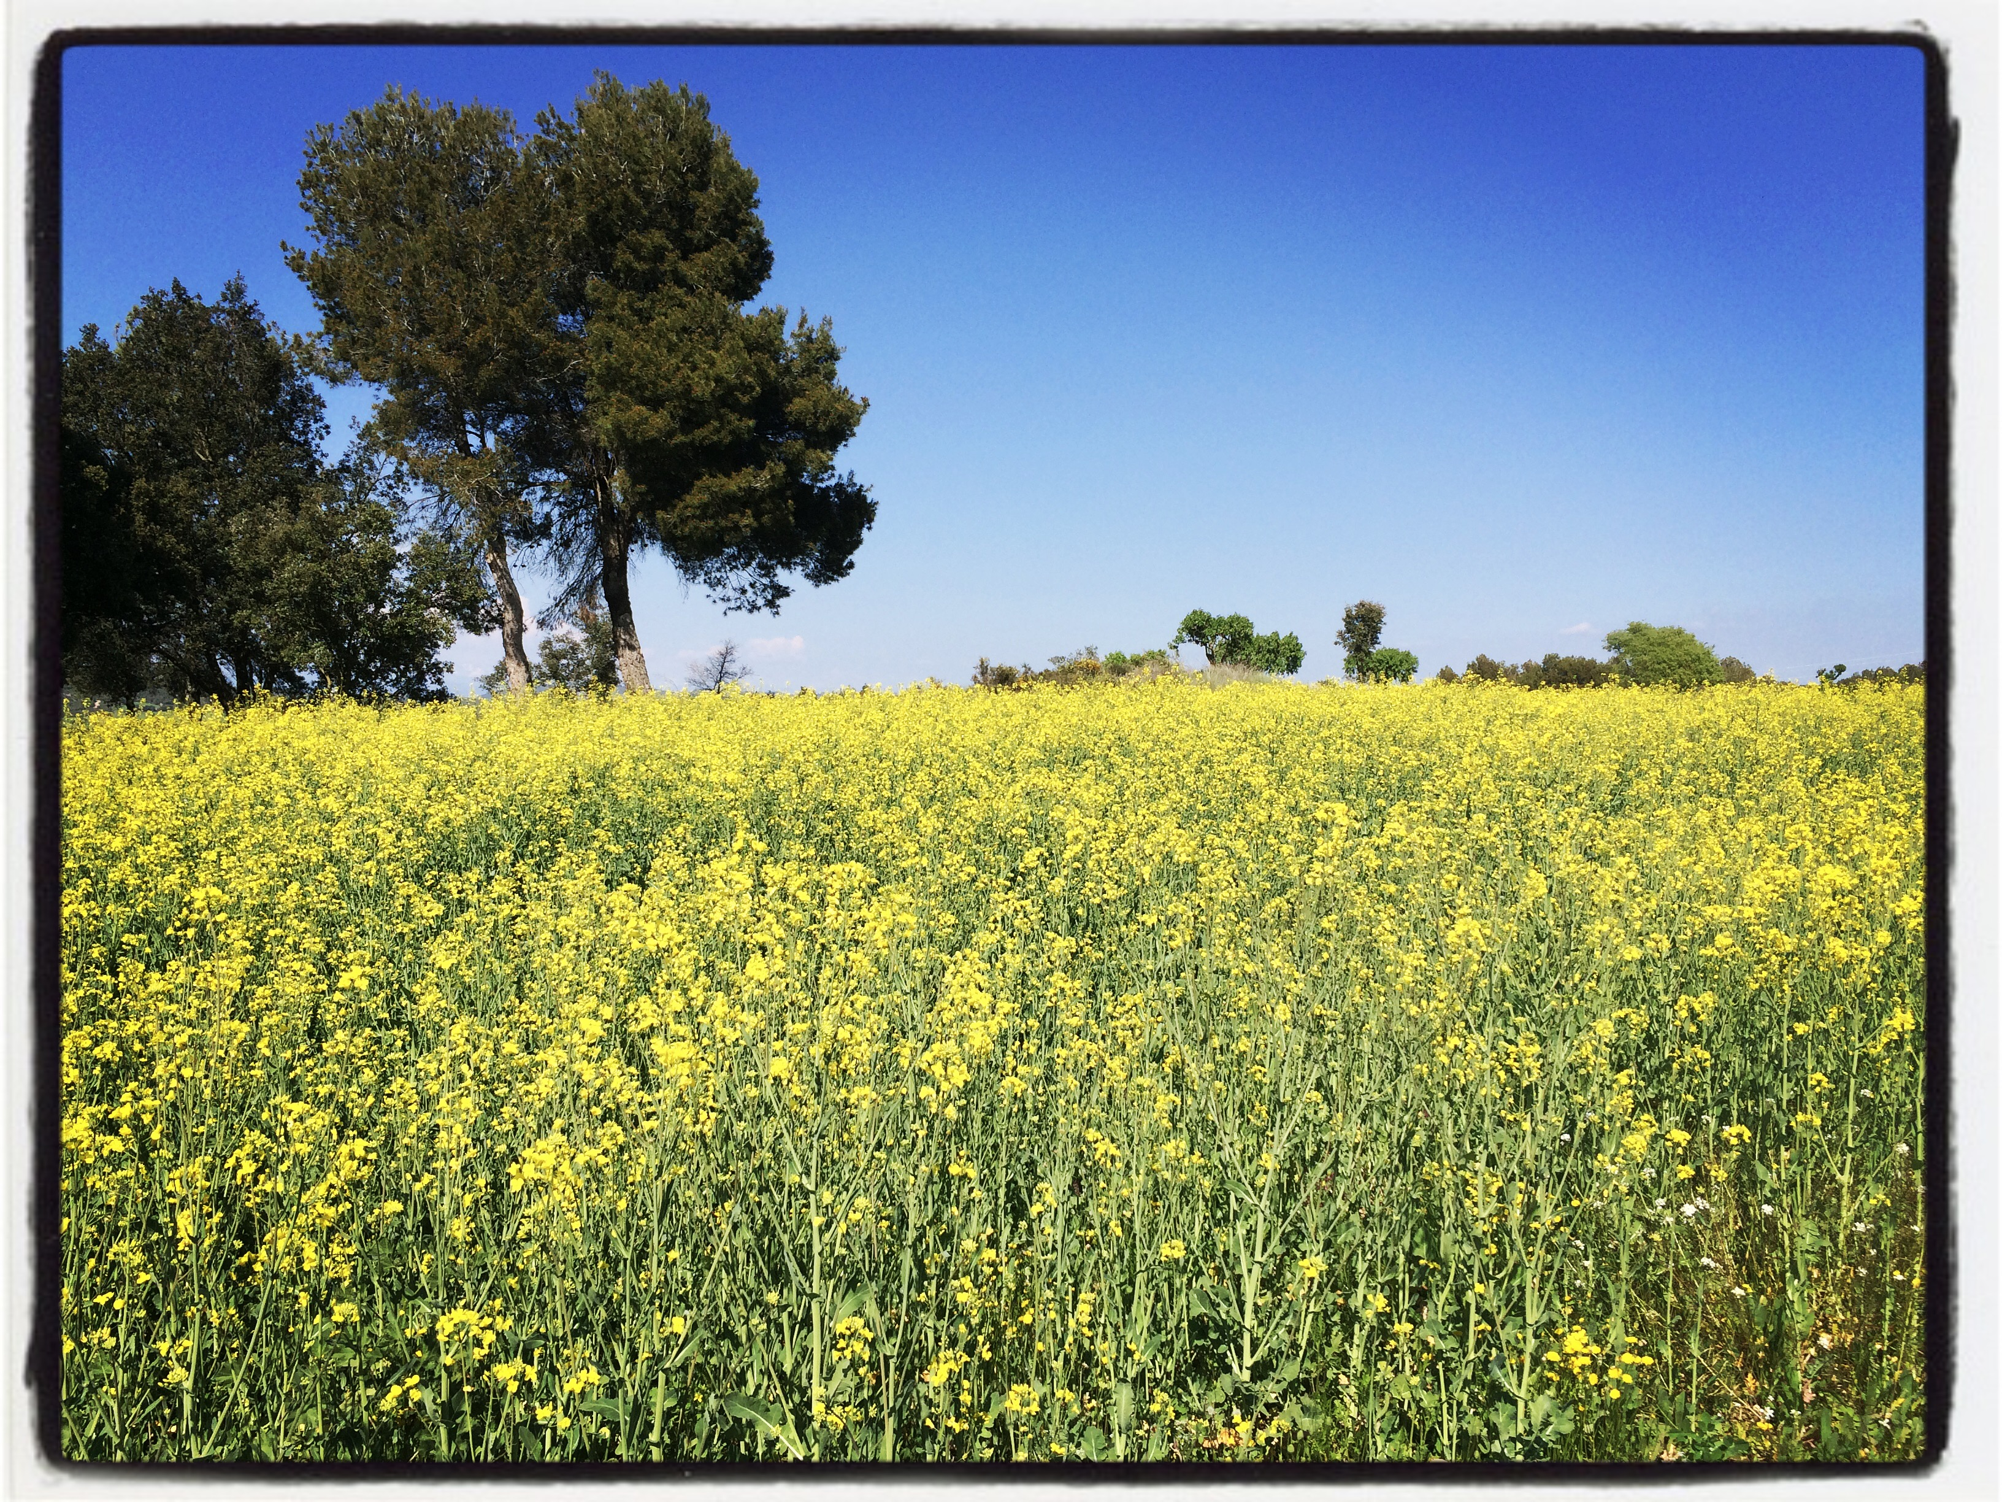
To wrap up…

Slide 46
Some good practices
Check guidance on Renewal
Follow structure Sections
Include all relevant study reports, raw data, certificates, papers from literature, scientific opinions
Clearly identify new and previously submitted data
Follow the guidance documents

Slide 47
13 April 2021
Questions and answers
Chair: Frank Verdonck
FEED Unit HoU a.i.

Slide 48
Questions during registration
Is the sensitivity limit for testing for the presence of DNA in the product - testing changing from 10 ng DNA/g or ml product? (Meeri Sutinen, Biosafe Ltd)
Would EFSA consider to only publish the reference list of the cited literature instead of the full scientific publication to avoid high copyright costs for the applicants? (Anouk Lanckriet, Huvepharma NV)

Slide 49
Questions during registration
What are the implications of the Transparency regulation (Regulation (EU) 2019/1381) on the renewal of the authorisation of feed additives? (Mikel Goñi, Pen&Tec Consulting SLU)
On average how long usually could take the whole authorisation, from the submission of the dossier to the publication on the feed additive register (Sara Roman, Prinova Europe)
Will there be additional technical meeting? (Sandra Mattioni, JYB Europe BV)

Slide 50
13 April 2021
Live questions and answers session

Slide 51
Q&A session
Questions on characterisation

Slide 52
Q&A session
Questions on safety

Slide 53
Q&A session
Questions on efficacy

Slide 54
Q&A session
Additional questions?

Slide 55
13 April 2021
Concluding remarks

Slide 56
Thank you for attending our event
Replies to pending questions will be addressed in writing and published on the EFSA website
The recording will be made available on the EFSA website
Thank you for filling out the survey that you will receive shortly by email. Your feedback is essential to improve our future events

